Slide 1
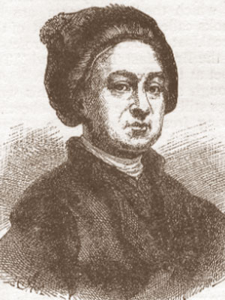
William Hogarth
( 1697-1764)

Slide 2
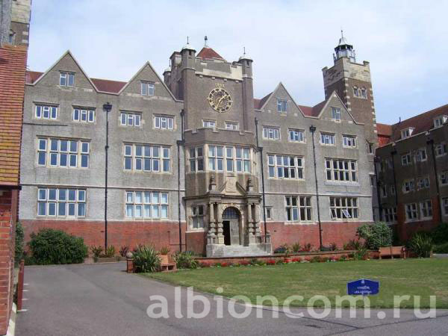
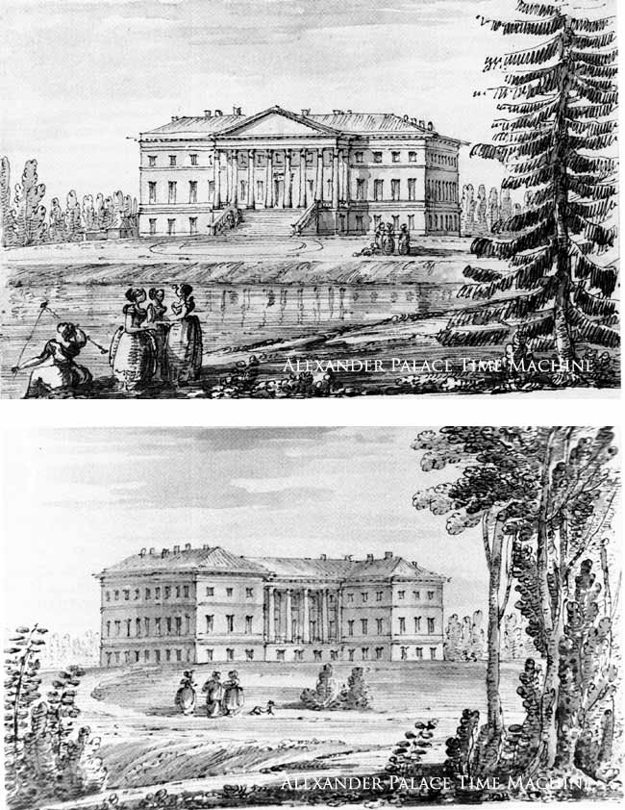
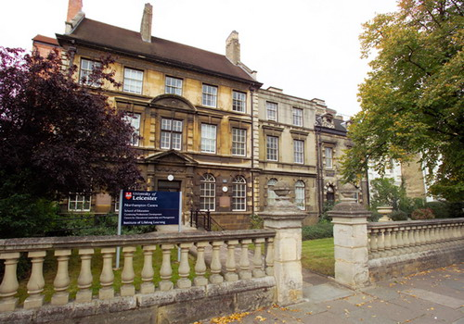
During the 18th century a national school of painting was created in England.

Slide 3
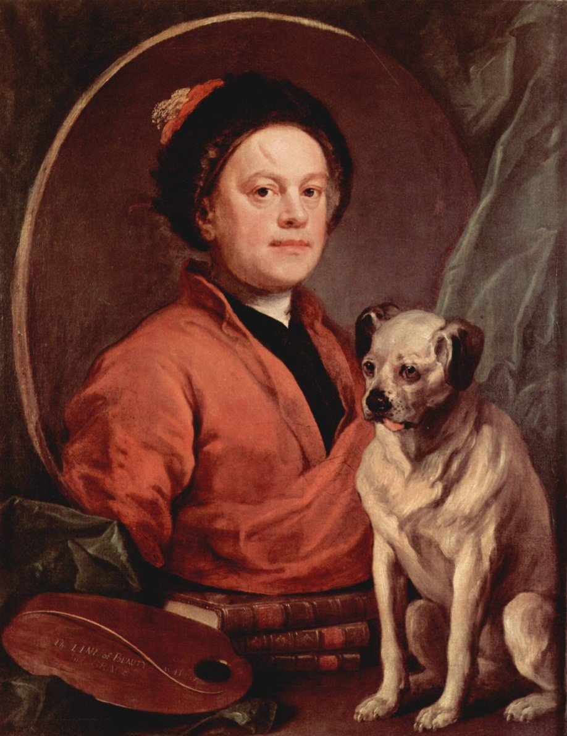
William Hogarth (1697-1764) was the first great English painter.

Slide 4
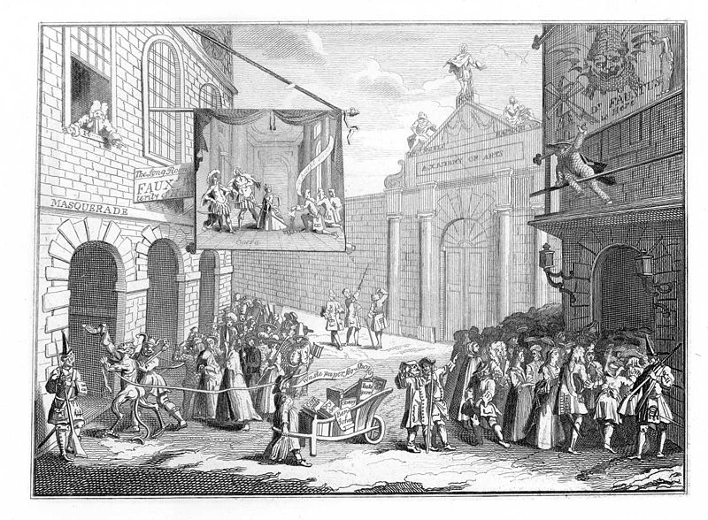
Masquerades and Operas

Slide 5
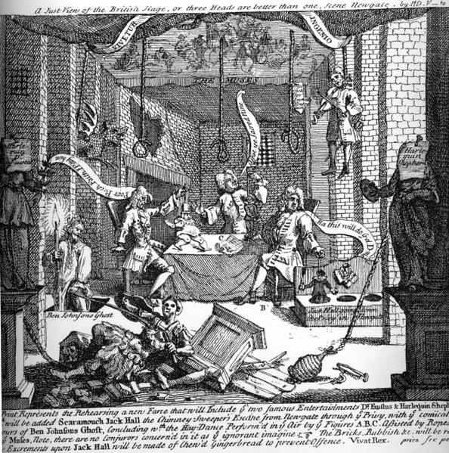
A Just View of the English Stage

Slide 6
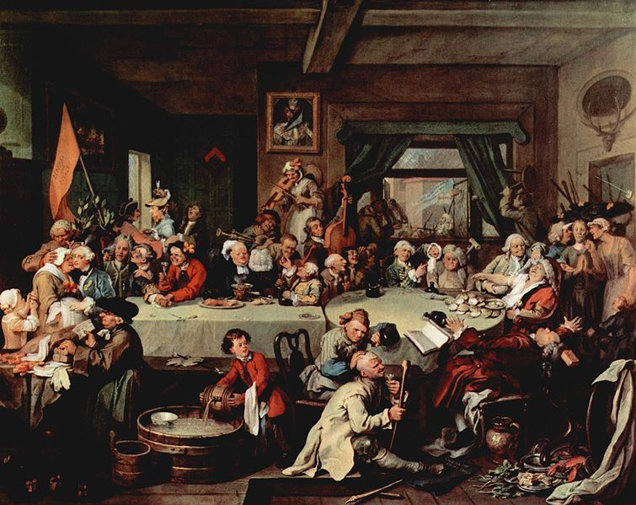
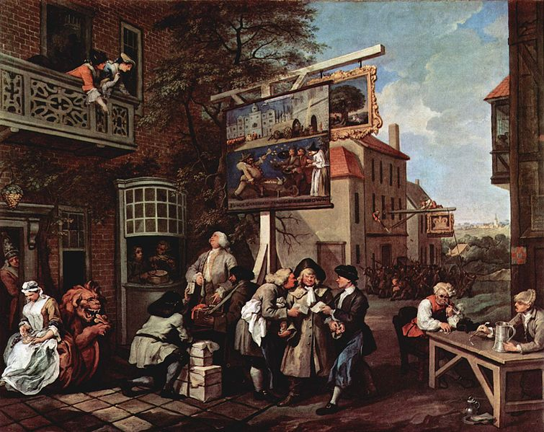
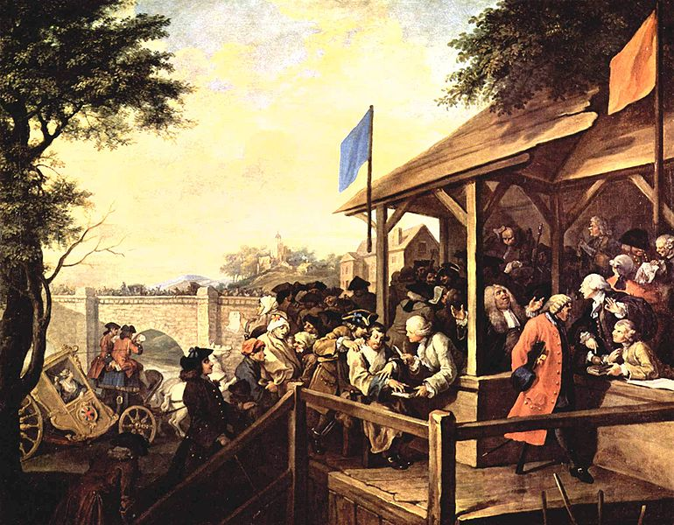
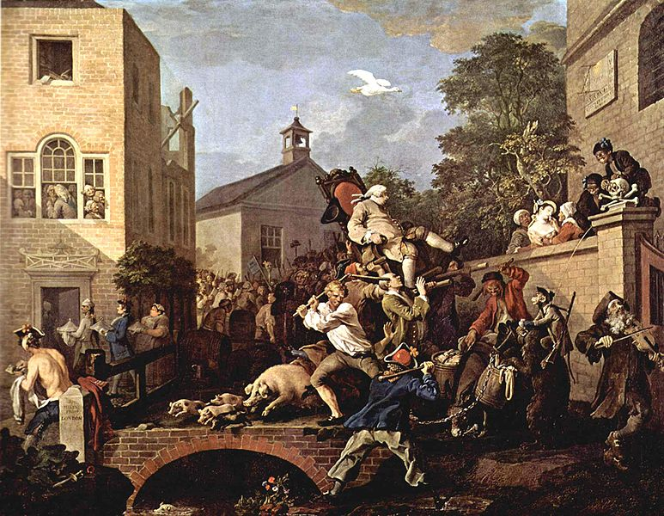
His pictures of social life brought him fame and acclaim.

Slide 7
One of the series of his – moral works ( Marriage a la mode) consists of 6 pictures and shows the life of London ( high society):

Slide 8
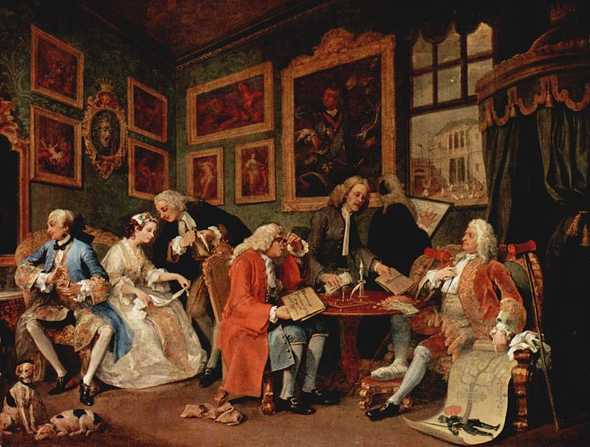
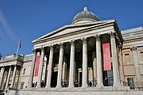
1.The Marriage Contract
National Gallery, London

Slide 9
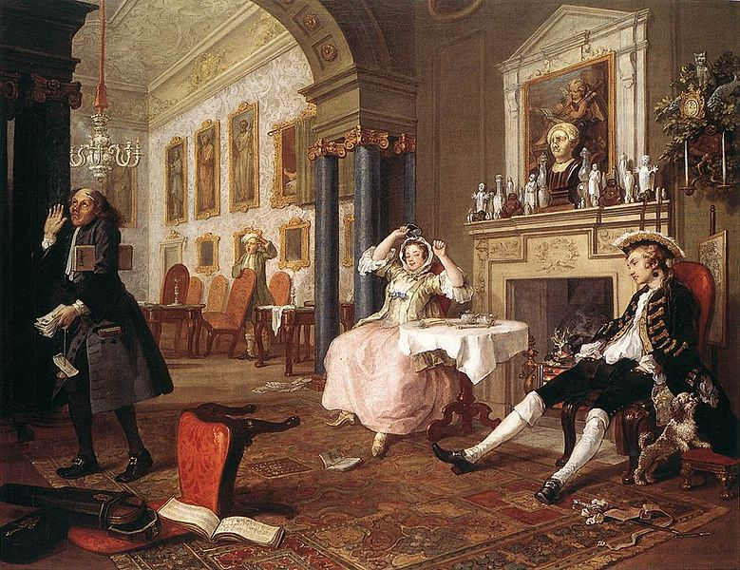
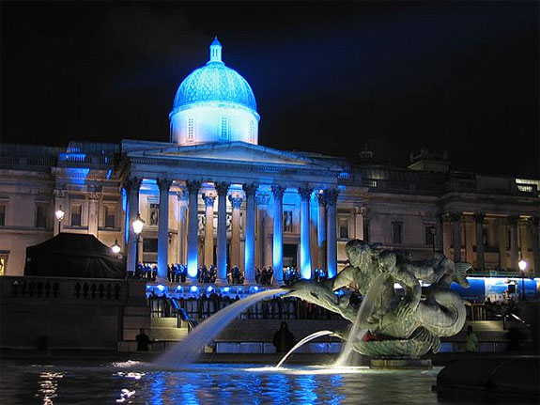
2.Shortly After the Marriage
National Gallery, London

Slide 10
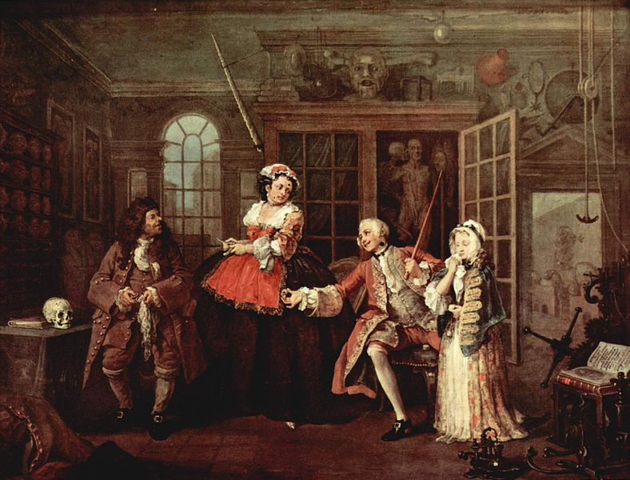
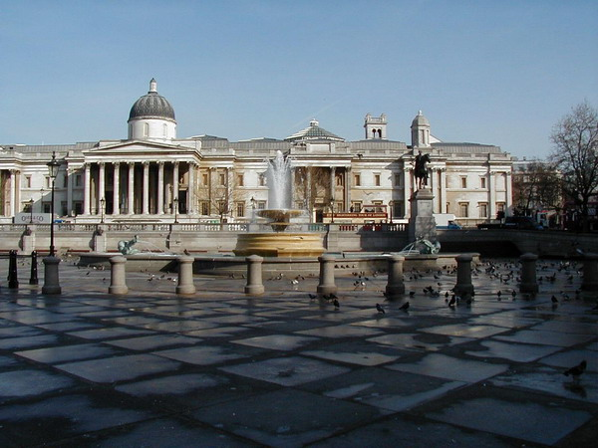
3.The Visit to the Quack Doctor
National Gallery, London

Slide 11
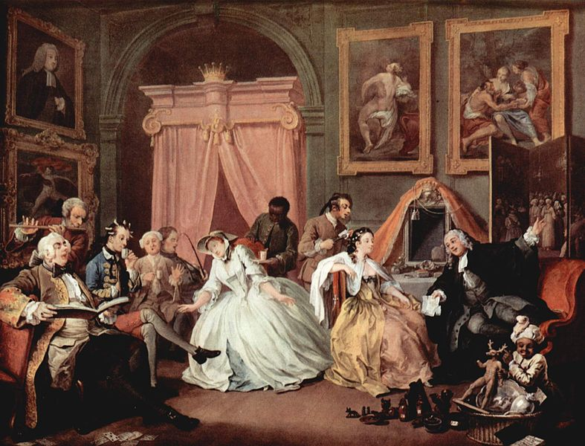
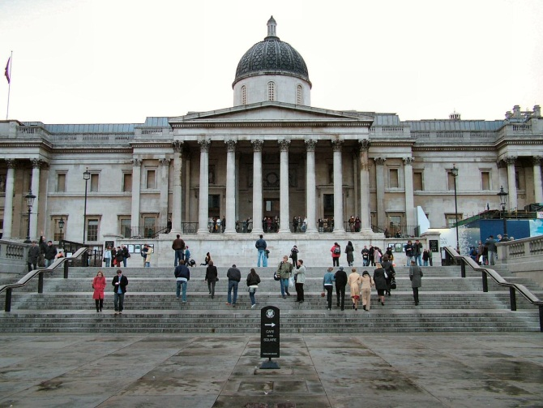
4.The Countess's Morning Levee
National Gallery, London

Slide 12
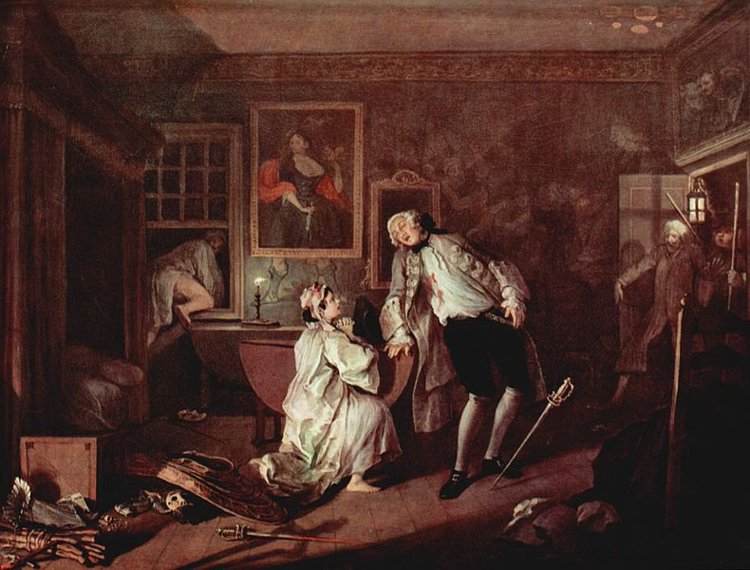
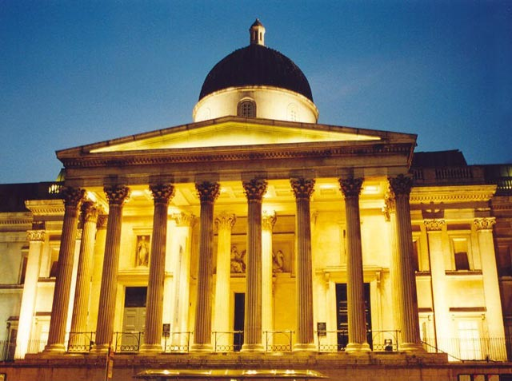
5.The Suicide of the Countess
National Gallery, London

Slide 13
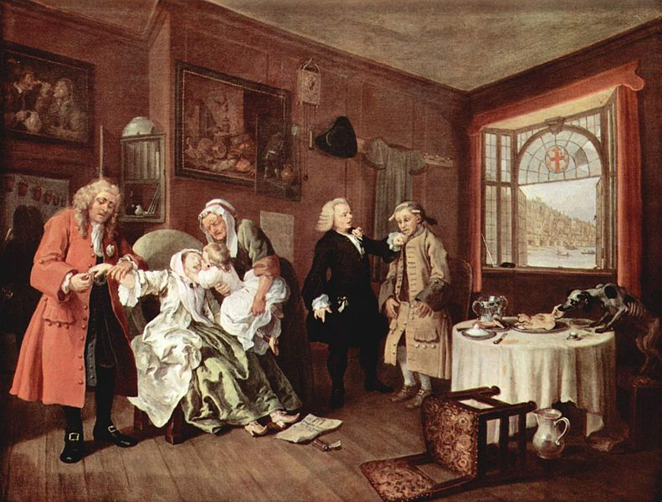
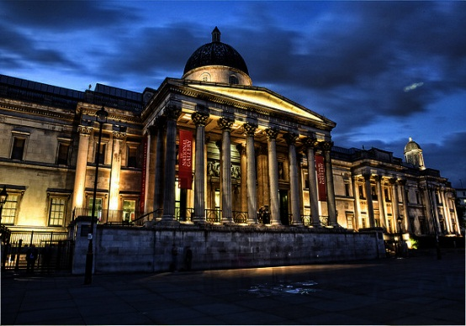
6.The Suicide of the Countess
National Gallery, London

Slide 14
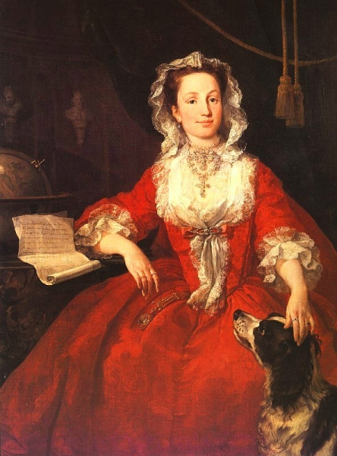
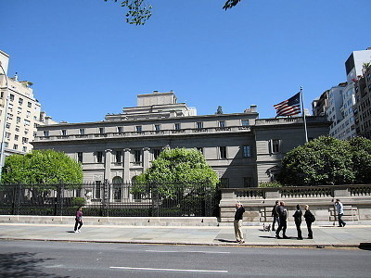
Portrait of Mary Edwards
THE FRICK COLLECTION

Slide 15
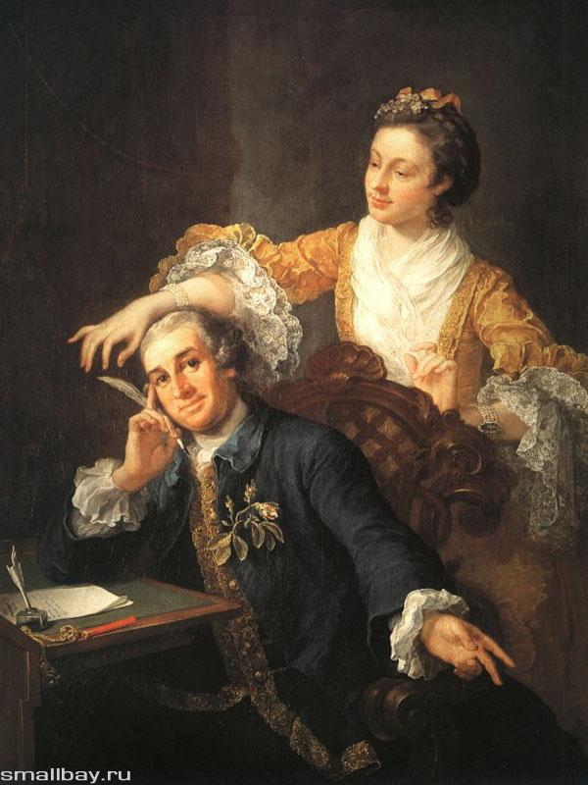
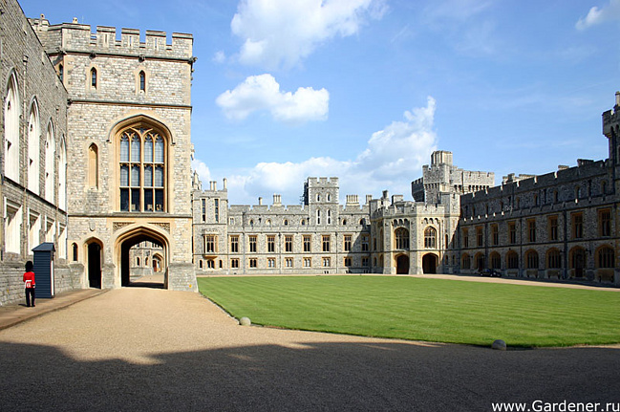
David Garrick with a wife
Royal collection, Windsor

Slide 16
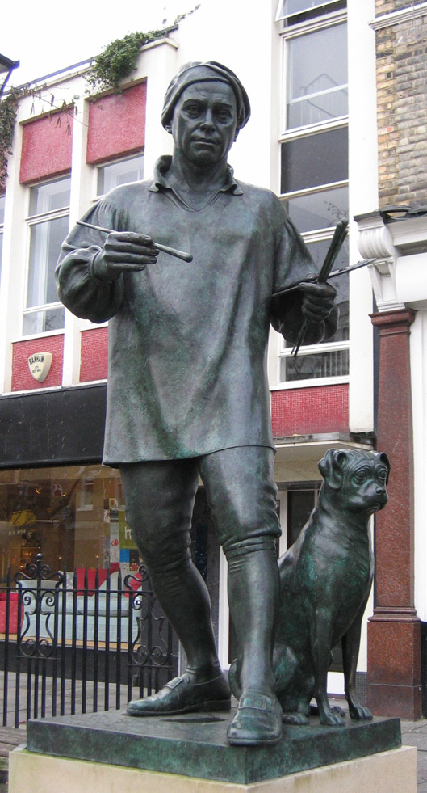
HOGARTH HAD NO PUPILS BUT ALMOST ALL ART IN ENGLAND HAS THE MARK OF HIS PERSONALITY.

