Slide 1
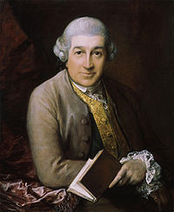
Tomas Gainsbourough (1727-1788)

Slide 2
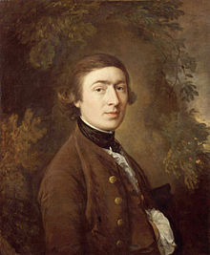
He was born in Sudbury,
Suffolk
of England.

Slide 3
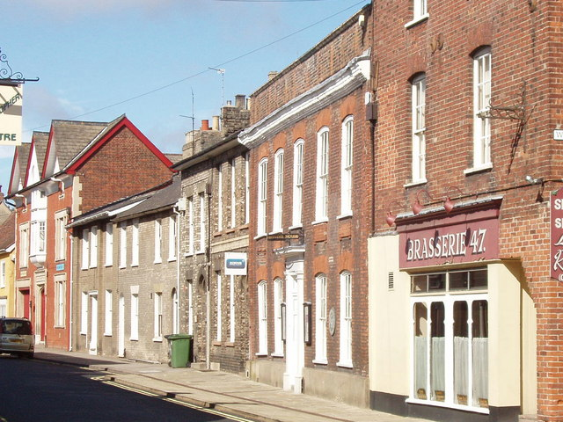
Gainsborough House

Slide 4
Portrait of Sarah Buxton

Slide 5
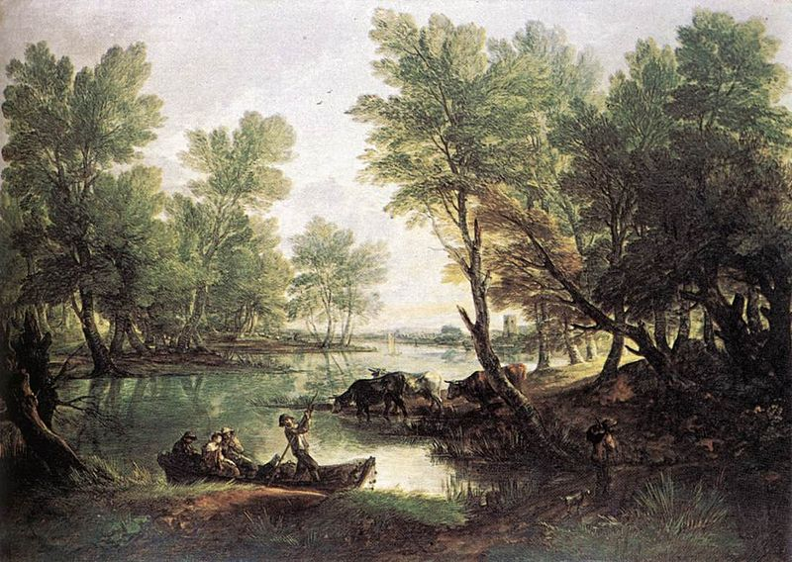
River Landscape (1768–1770)

Slide 6
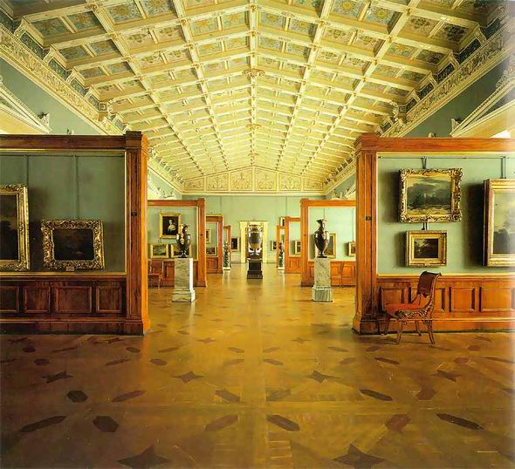
St. Petersburg, the Hermitage, the Dutch Hall

Slide 7
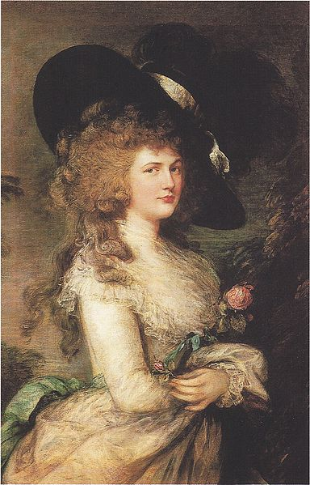
Lady Georgiana Cavendish (1787)

Slide 8
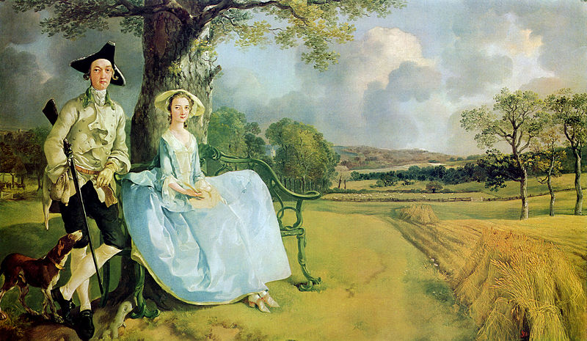
Mr. and Mrs. Robert Andrews (1748)

Slide 9
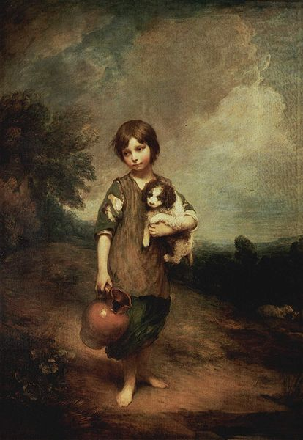
Cottage Girl with Dog and pitcher (1785)

Slide 10
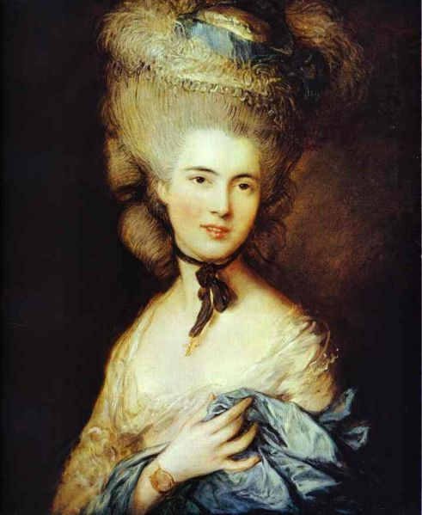
Lady in Blue (1770)

Slide 11
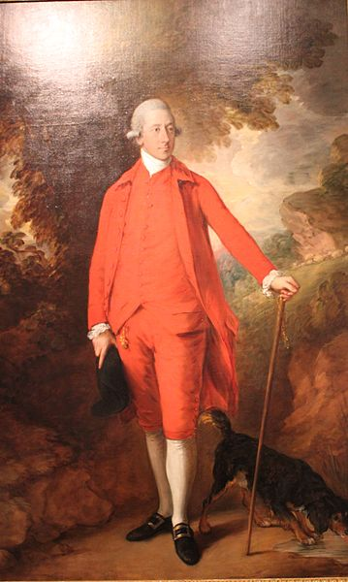
The Honorable Richard
(1778–80)

Slide 12
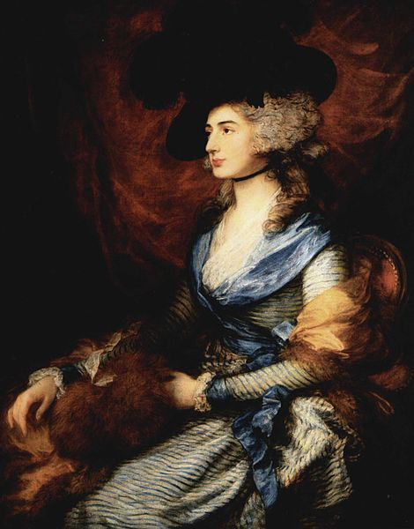
Portrait of Mrs. Sarah Siddons (1755-1831)

Slide 13
HIS BEST LANSCAPES

Slide 14
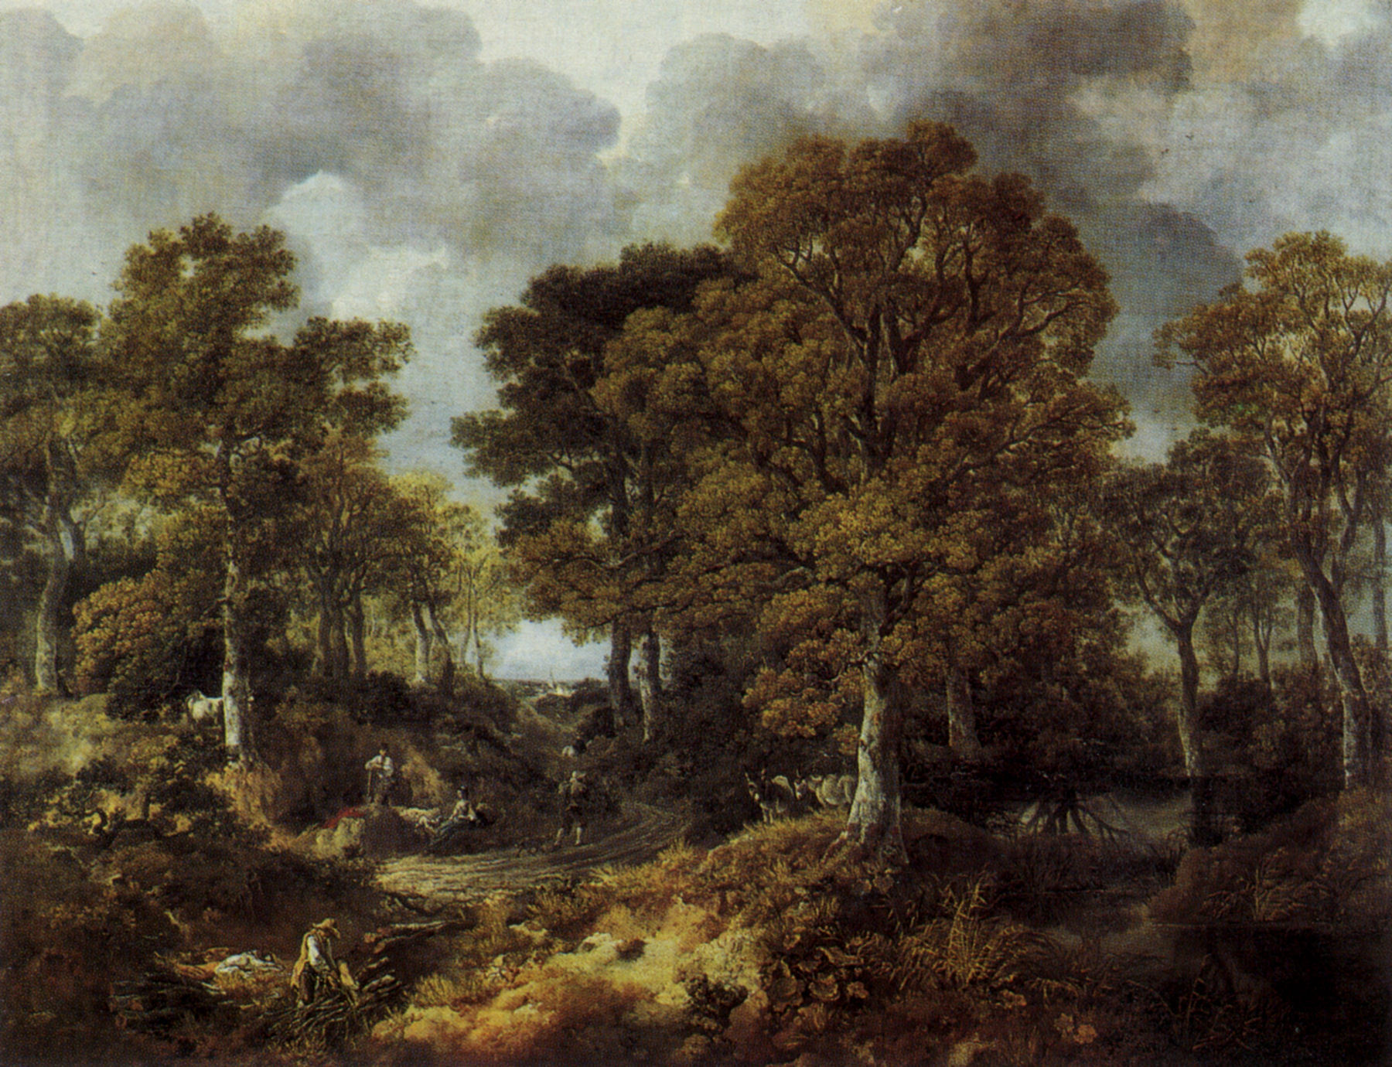
Cornard Wood

Slide 15
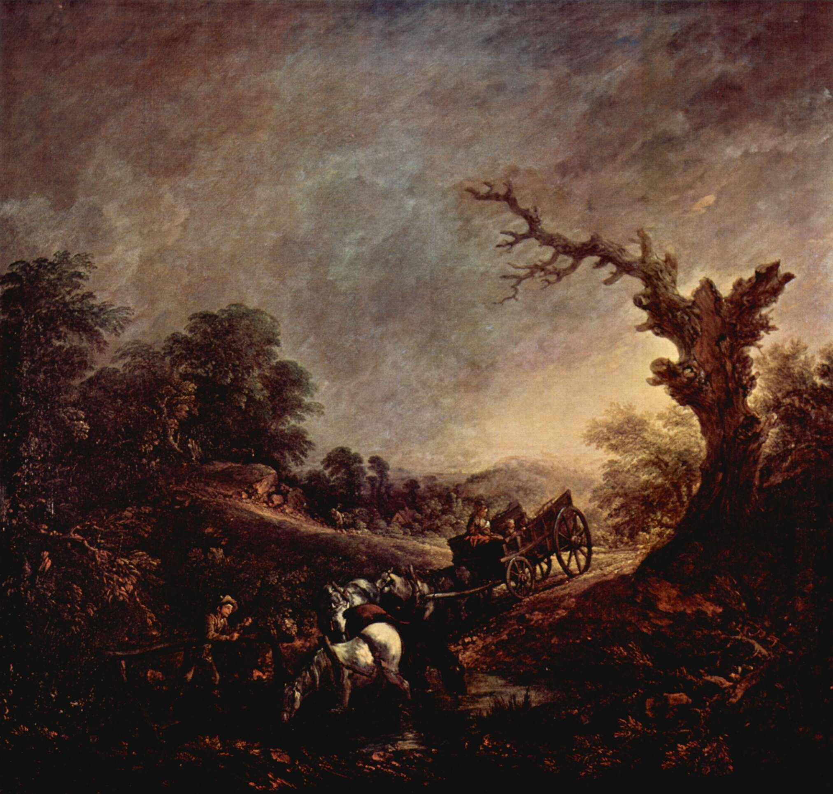
Sunset (1760)

Slide 16
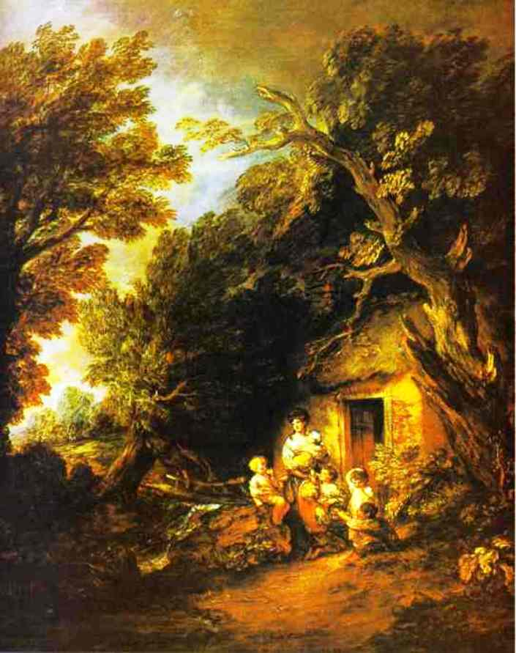
The cottage door

Slide 17
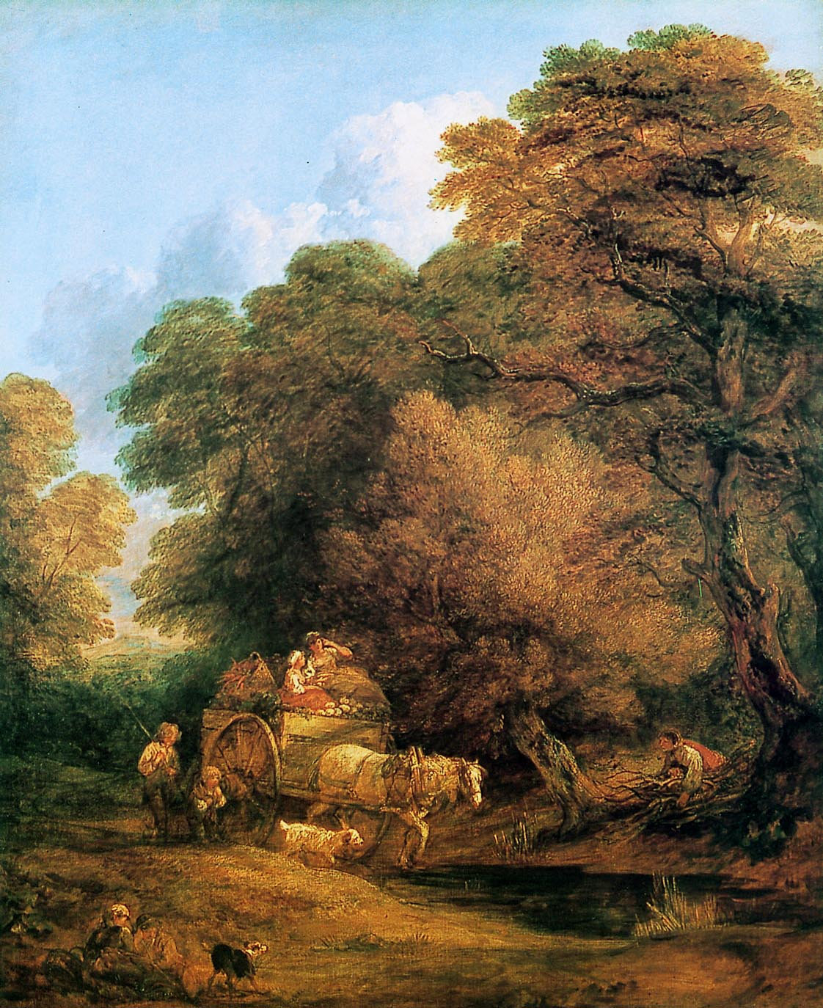
The market cart

Slide 18
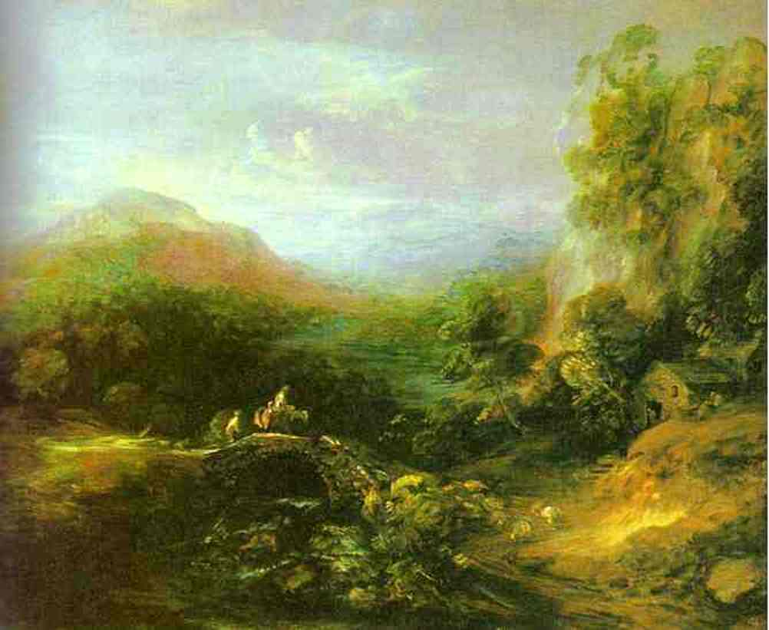
The bridge

