Slide 1
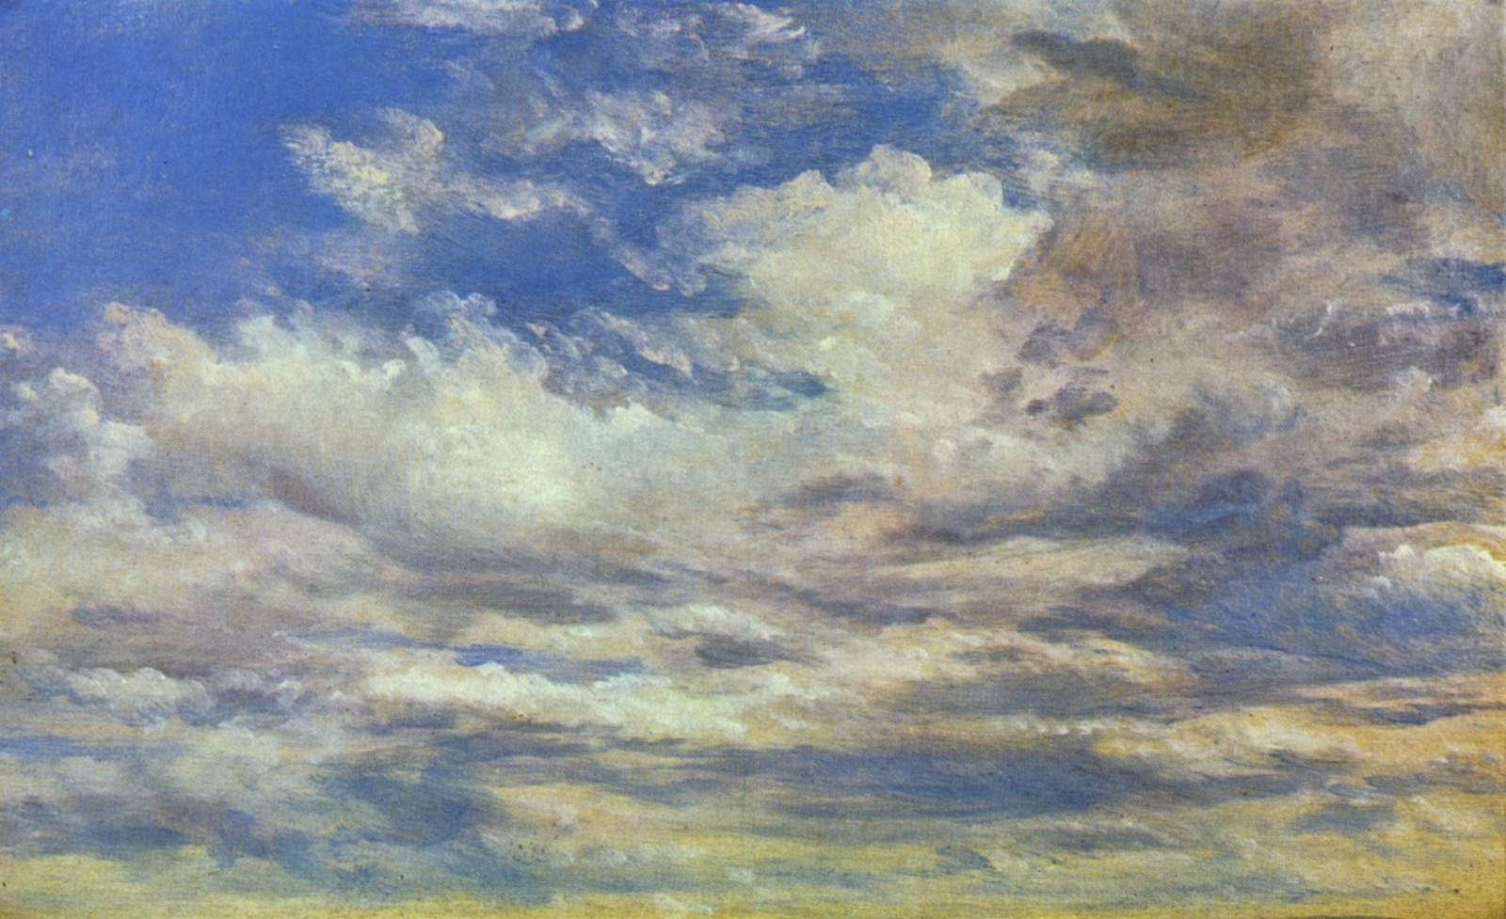
JOHN CONSTABLE

Slide 2
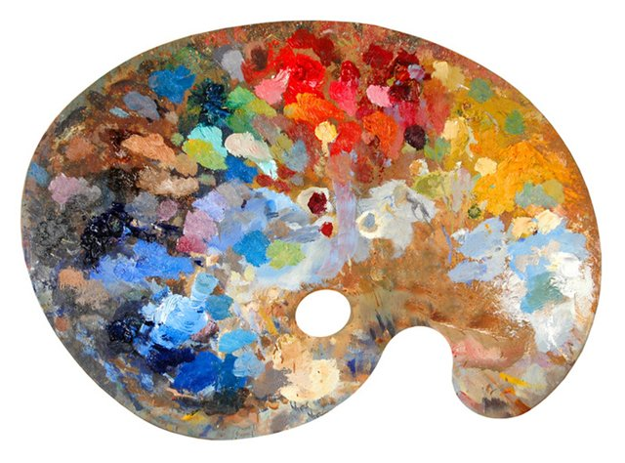
LANDSCAPE PAINTING

Slide 3
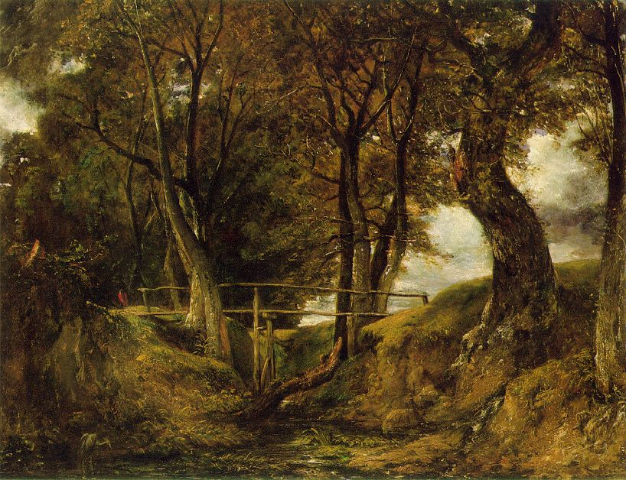
XIX

Slide 4
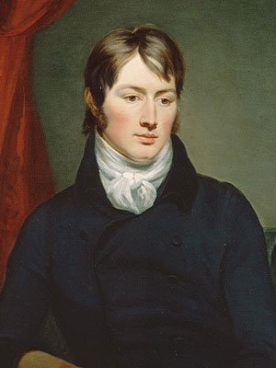
John Constable
(1776-1837)
A famous English landscape painter of 19th century.

Slide 5
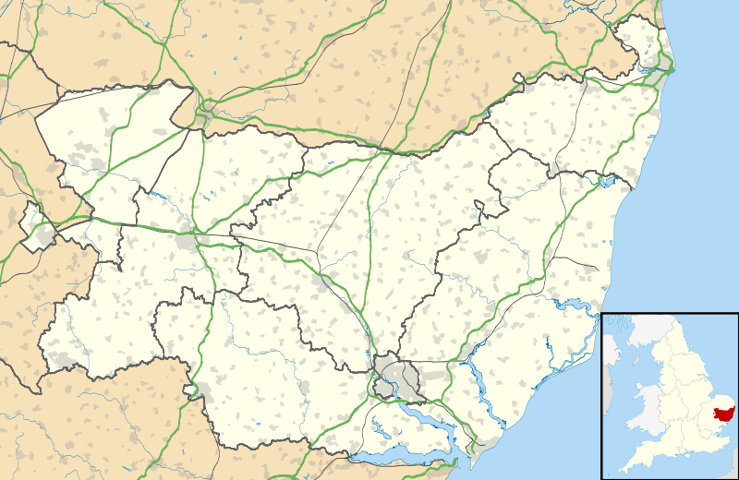
East Bergholt

Slide 6
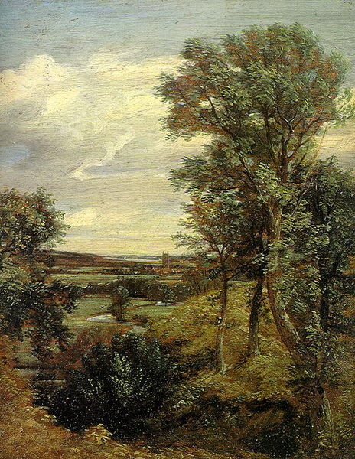
“Dedham Vale”
Victoria and Albert Museum, London, UK

Slide 7
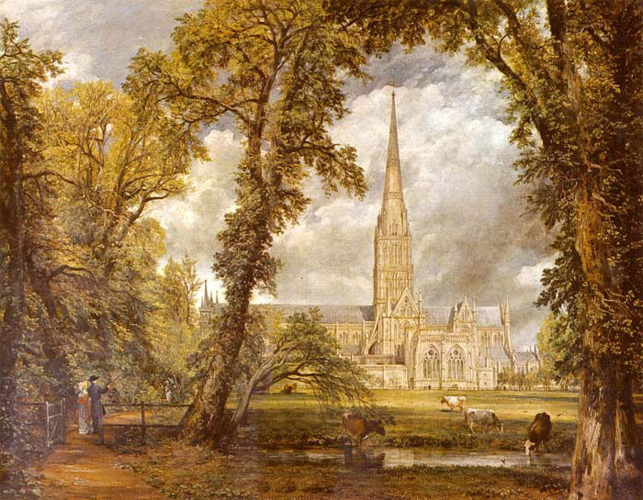
"Salisbury Cathedral from the Bishop's Grounds"
Victoria and Albert Museum, London, UK

Slide 8
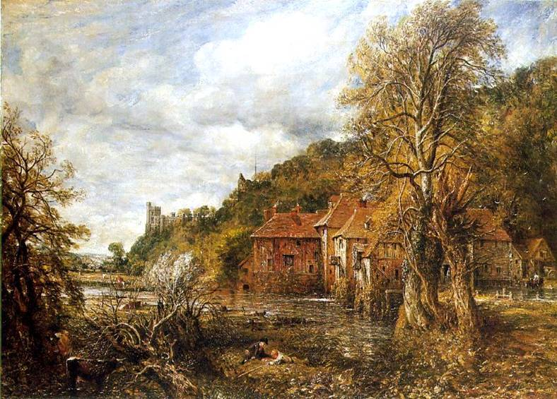

Slide 9
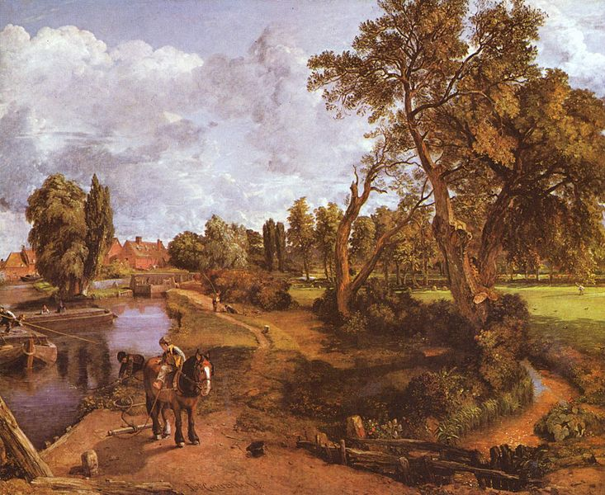
“ Flatford Mill “
Tate Gallery, London, UK

Slide 10
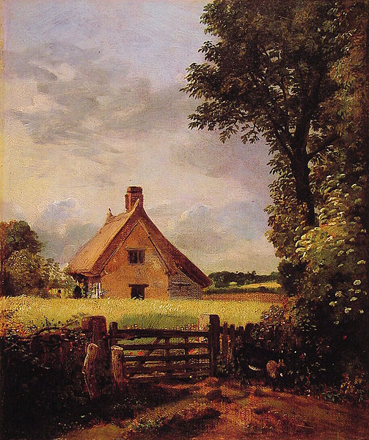
“ A Cottage in a Cornfield ”
National Museum Wales, Cardiff , UK

Slide 11
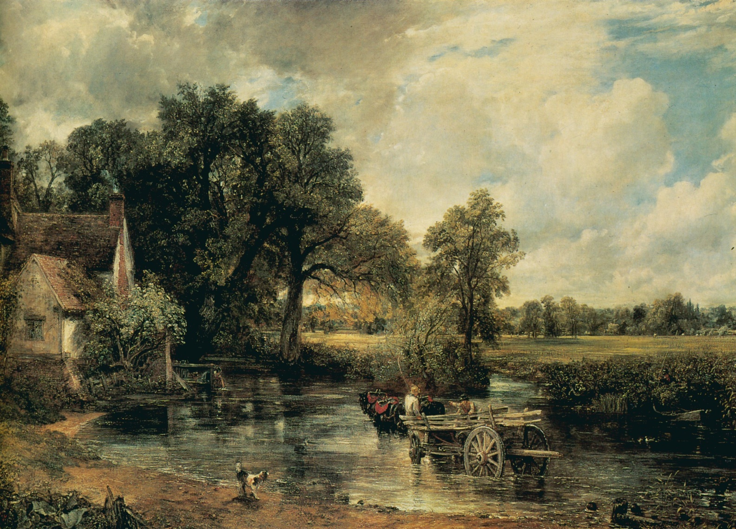
“ The Hay Wain”
National Gallery, London, UK

Slide 12
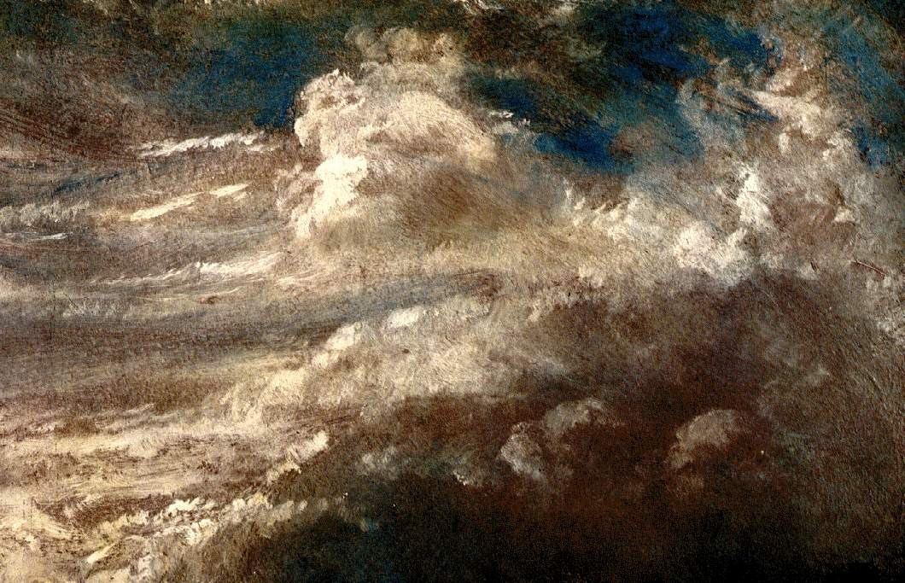
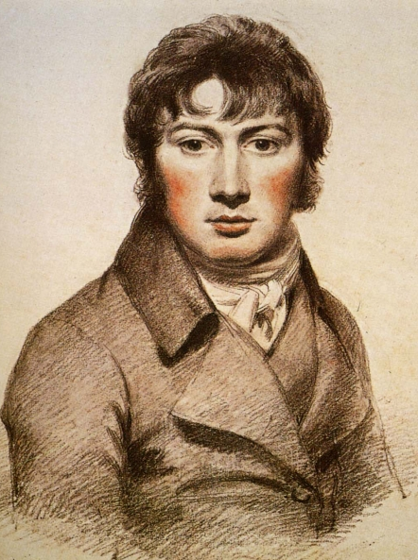

Slide 13
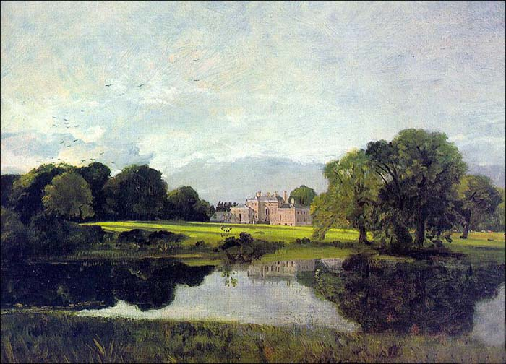
“Malvern Hall”
Tate Gallery, London, UK

Slide 14
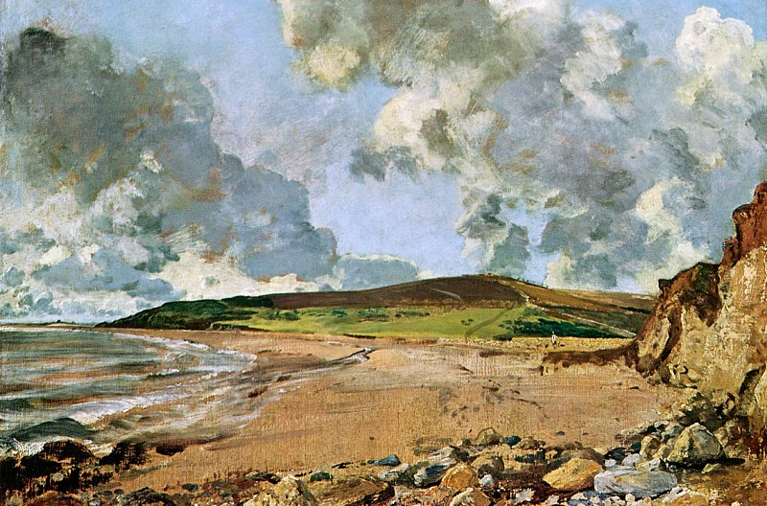
“Weymouth bay”
National Gallery, London, UK

Slide 15
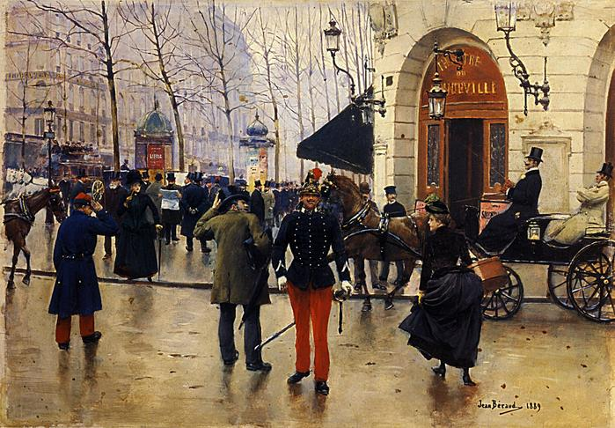
France

Slide 16
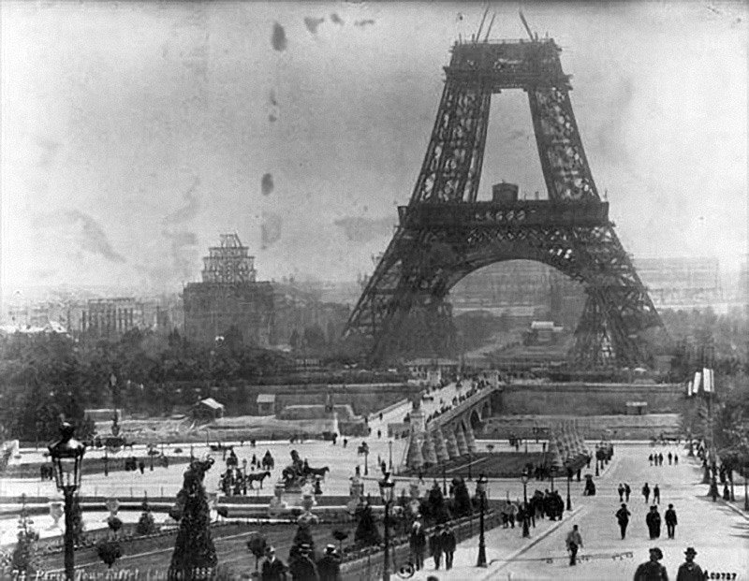
1824

Slide 17
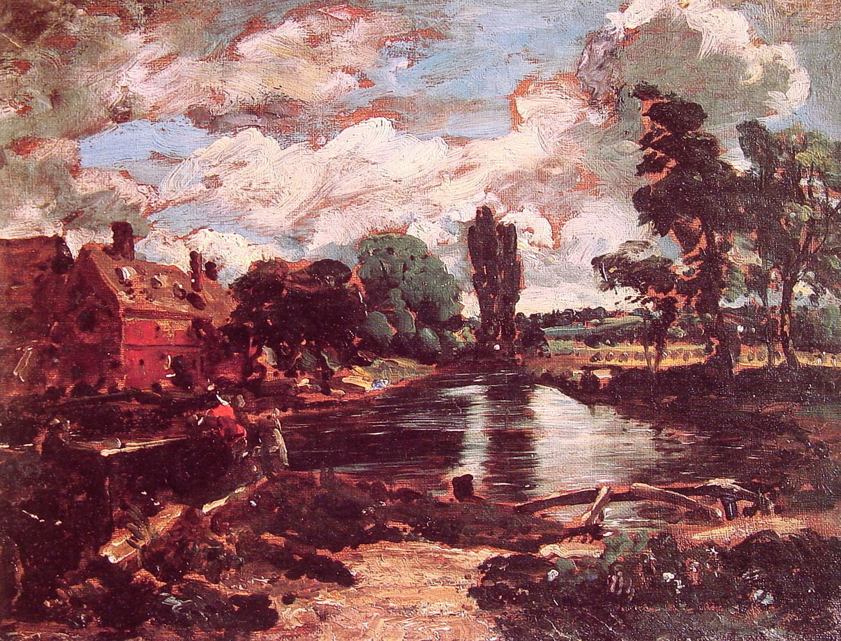
”Flatford Mill from the lock”
Kunsthistorisches Museum, Austria

Slide 18
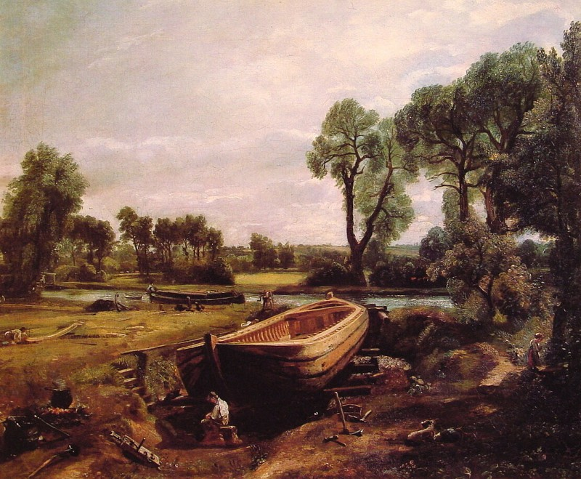
“Boat Building”
Victoria and Albert Museum, London, UK

Slide 19
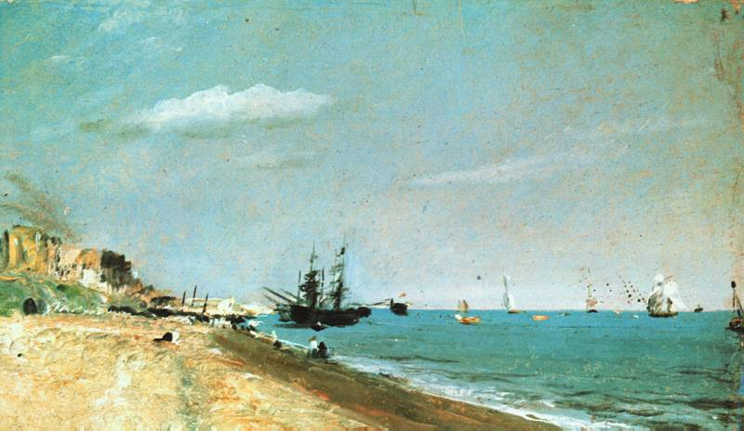
“Brighton Beach”
Kunsthistorisches Museum, Austria

