Slide 2
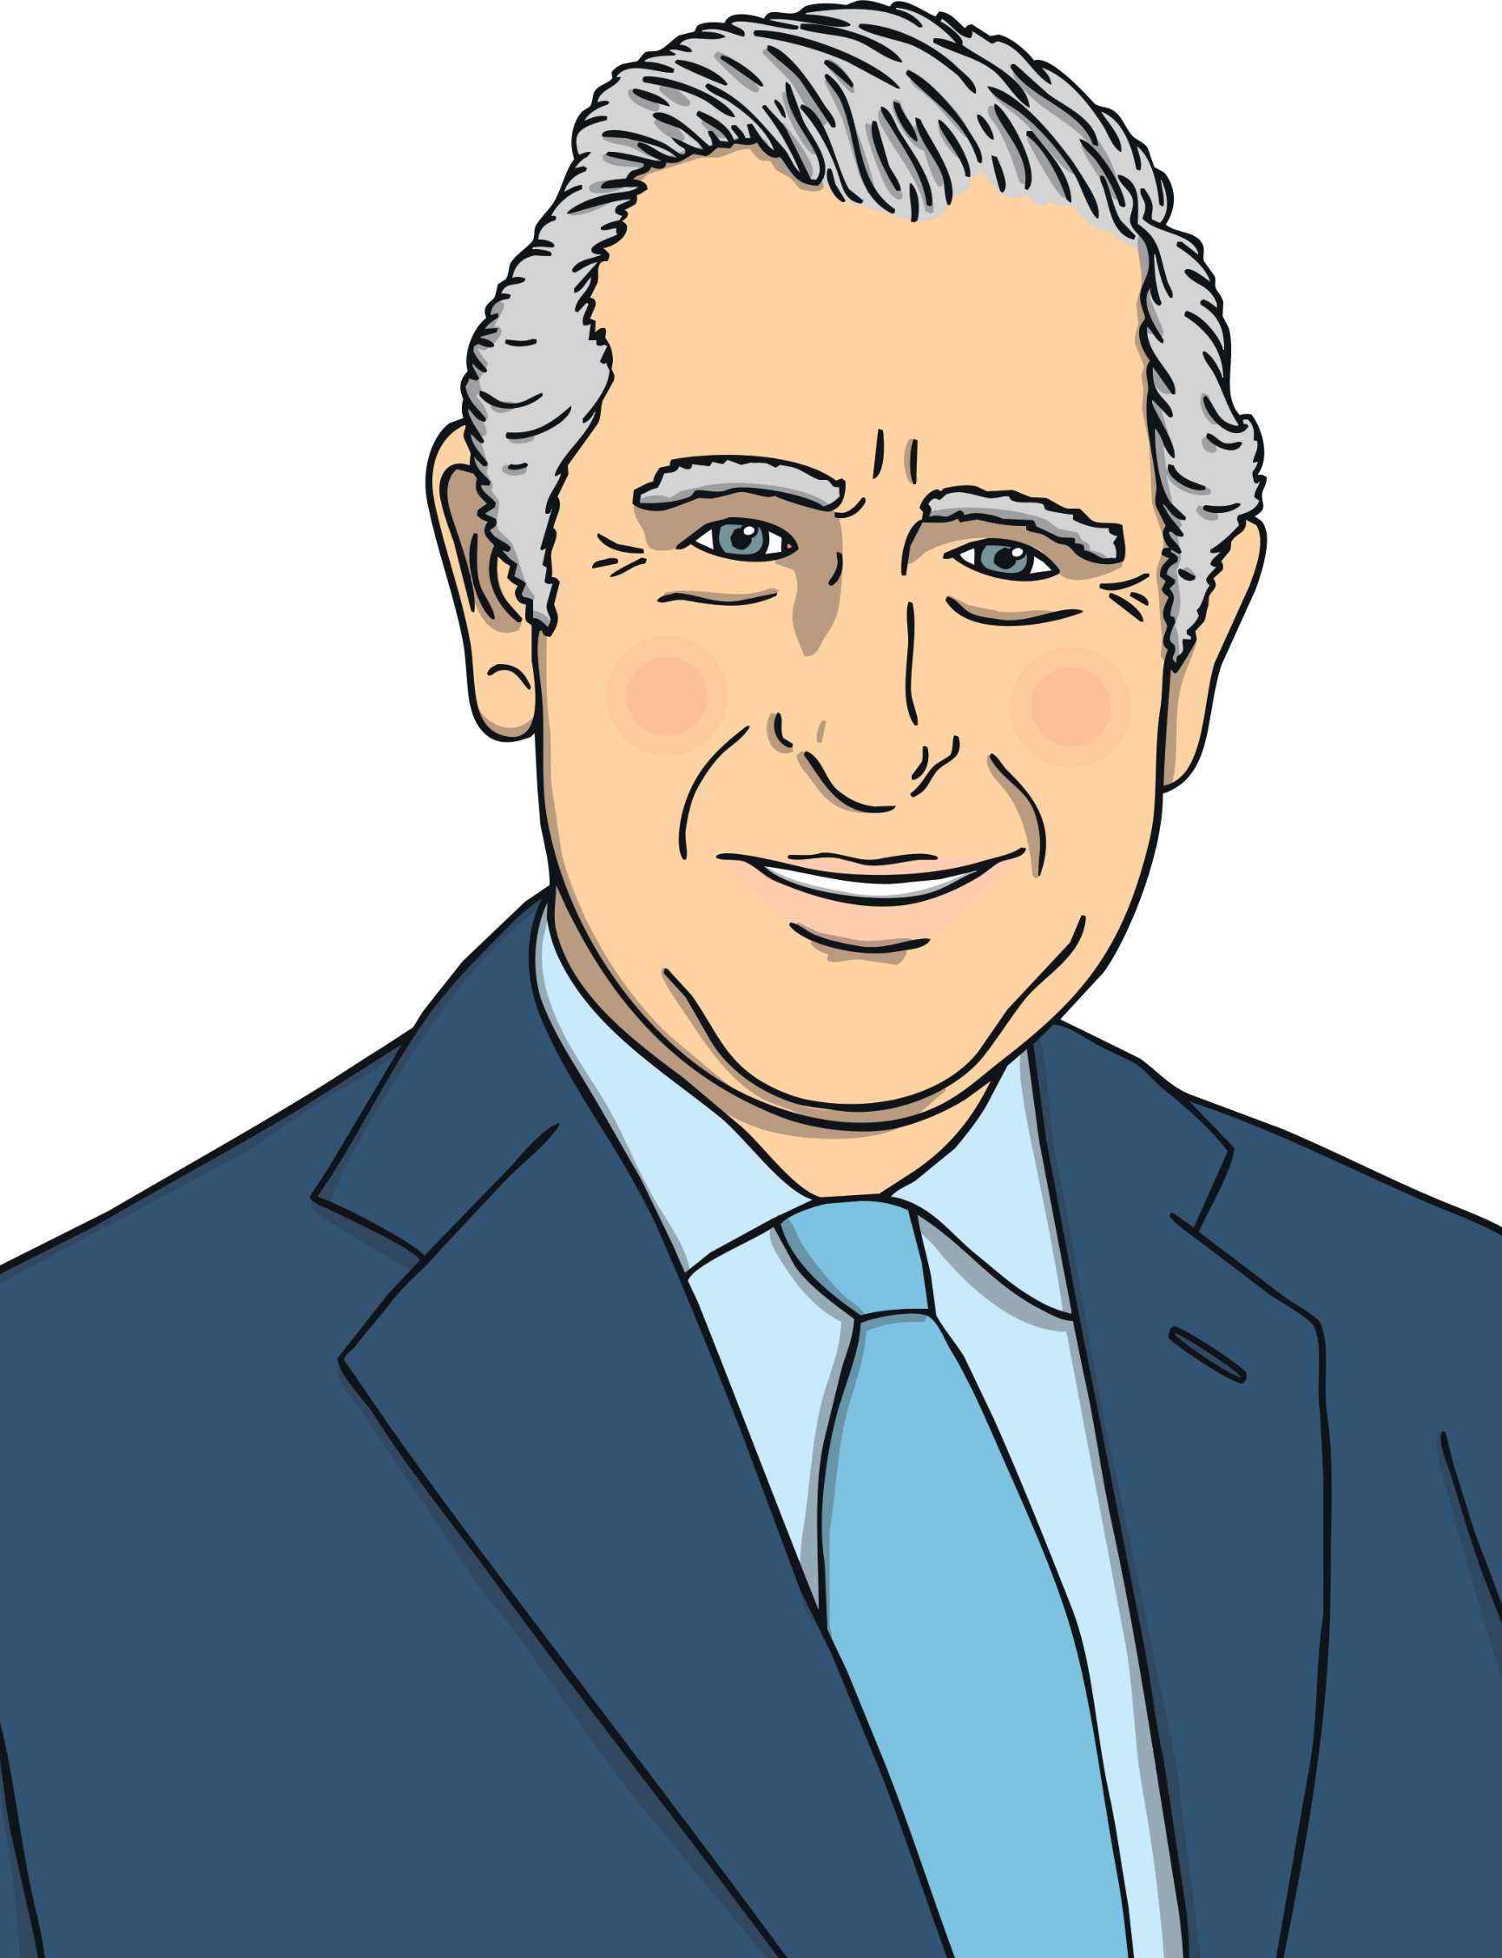
King Charles
The King’s full name is Charles Philip Arthur George.
King Charles has 2 sons: Prince William and Prince Harry.
In 1976, he started the charity ‘The Prince’s Trust’. The charity helps support young people.

Slide 3
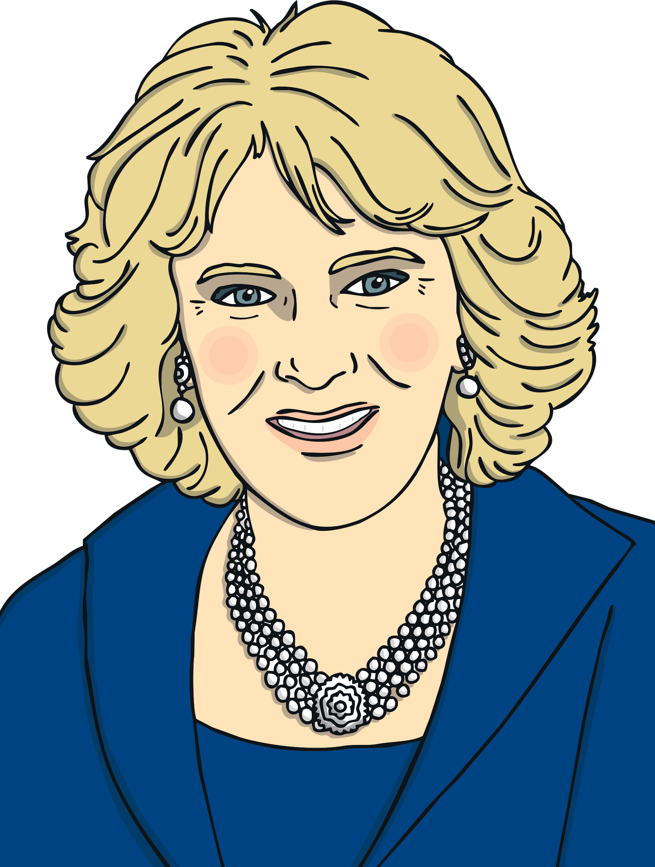
The Queen Consort
The Queen Consort is married to King Charles.
Her full name is Camilla Rosemary Shand.
The Queen Consort has 2 children of her own and is step-mother to King Charles’ sons, Prince William and Prince Harry.

Slide 4
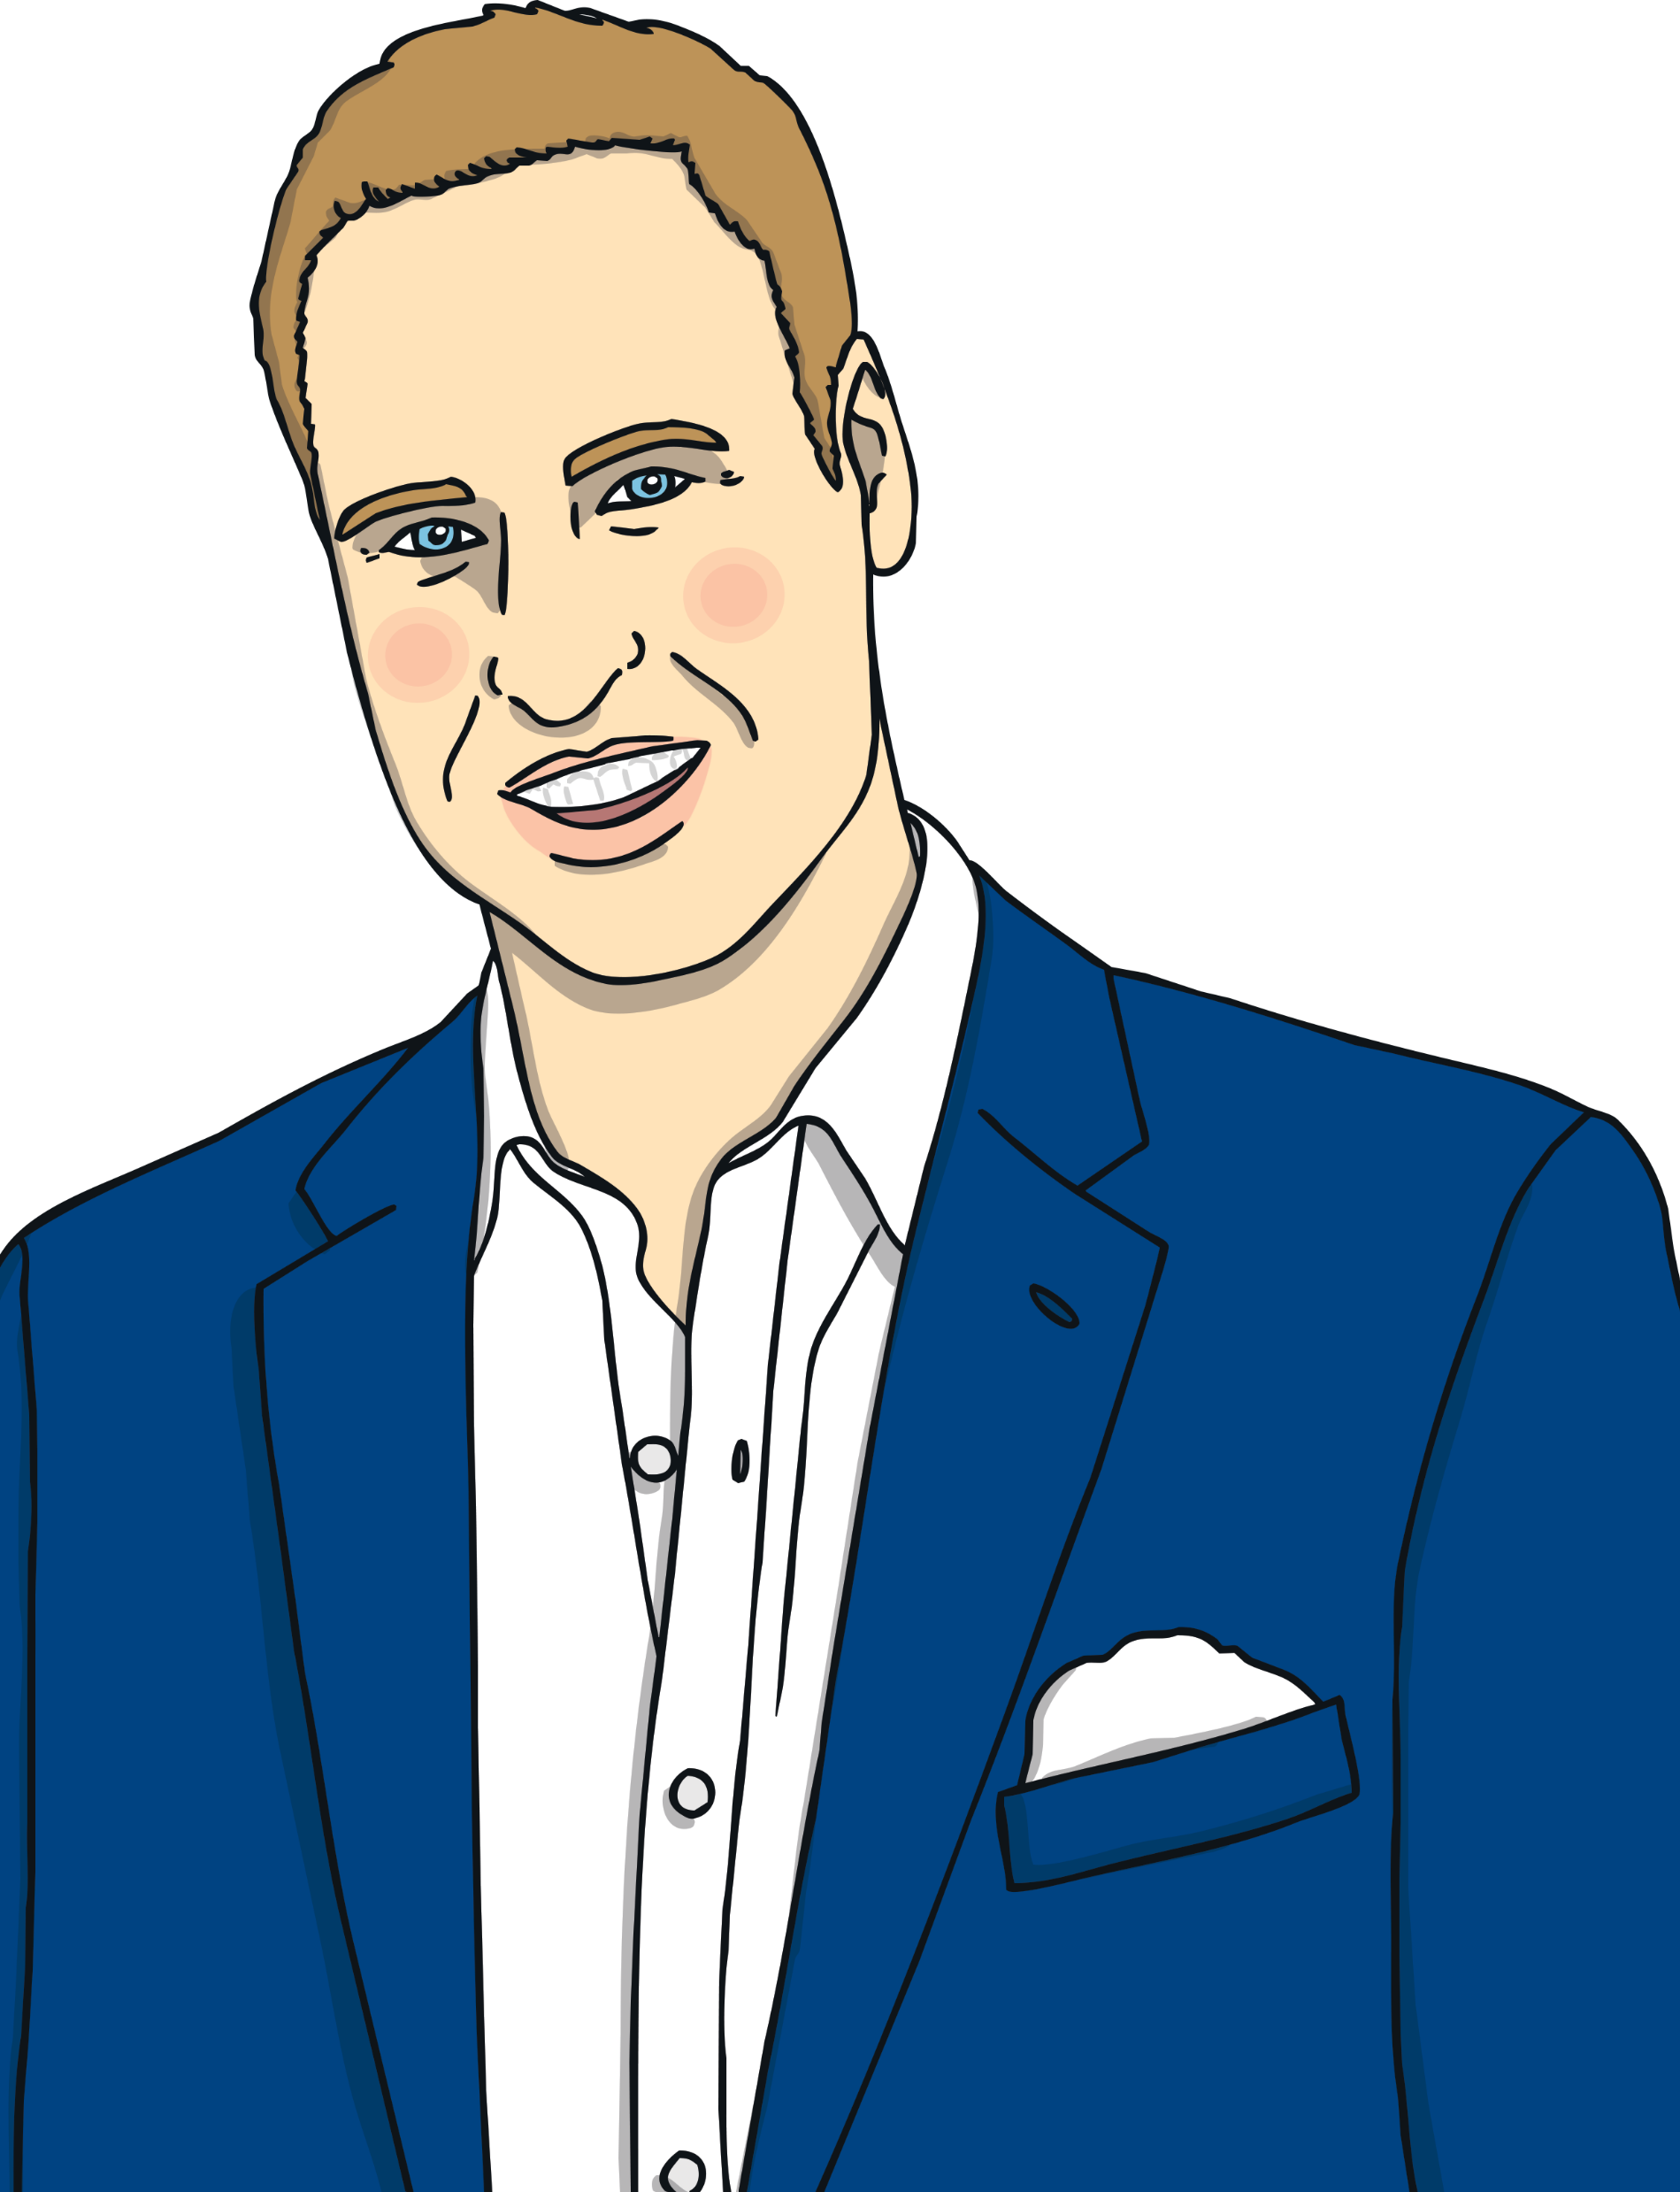
Prince William
Prince William’s full name is William Arthur Philip Louis.
His royal title is Duke of Cambridge.
He is second in line to the throne after his father, Prince Charles.
His mother was Diana, Princess of Wales.
He is married to Catherine, Duchess of Cambridge.
Prince William has 3 children: Prince George, Princess Charlotte and Prince Louis.
He used to be an air ambulance pilot.

Slide 5
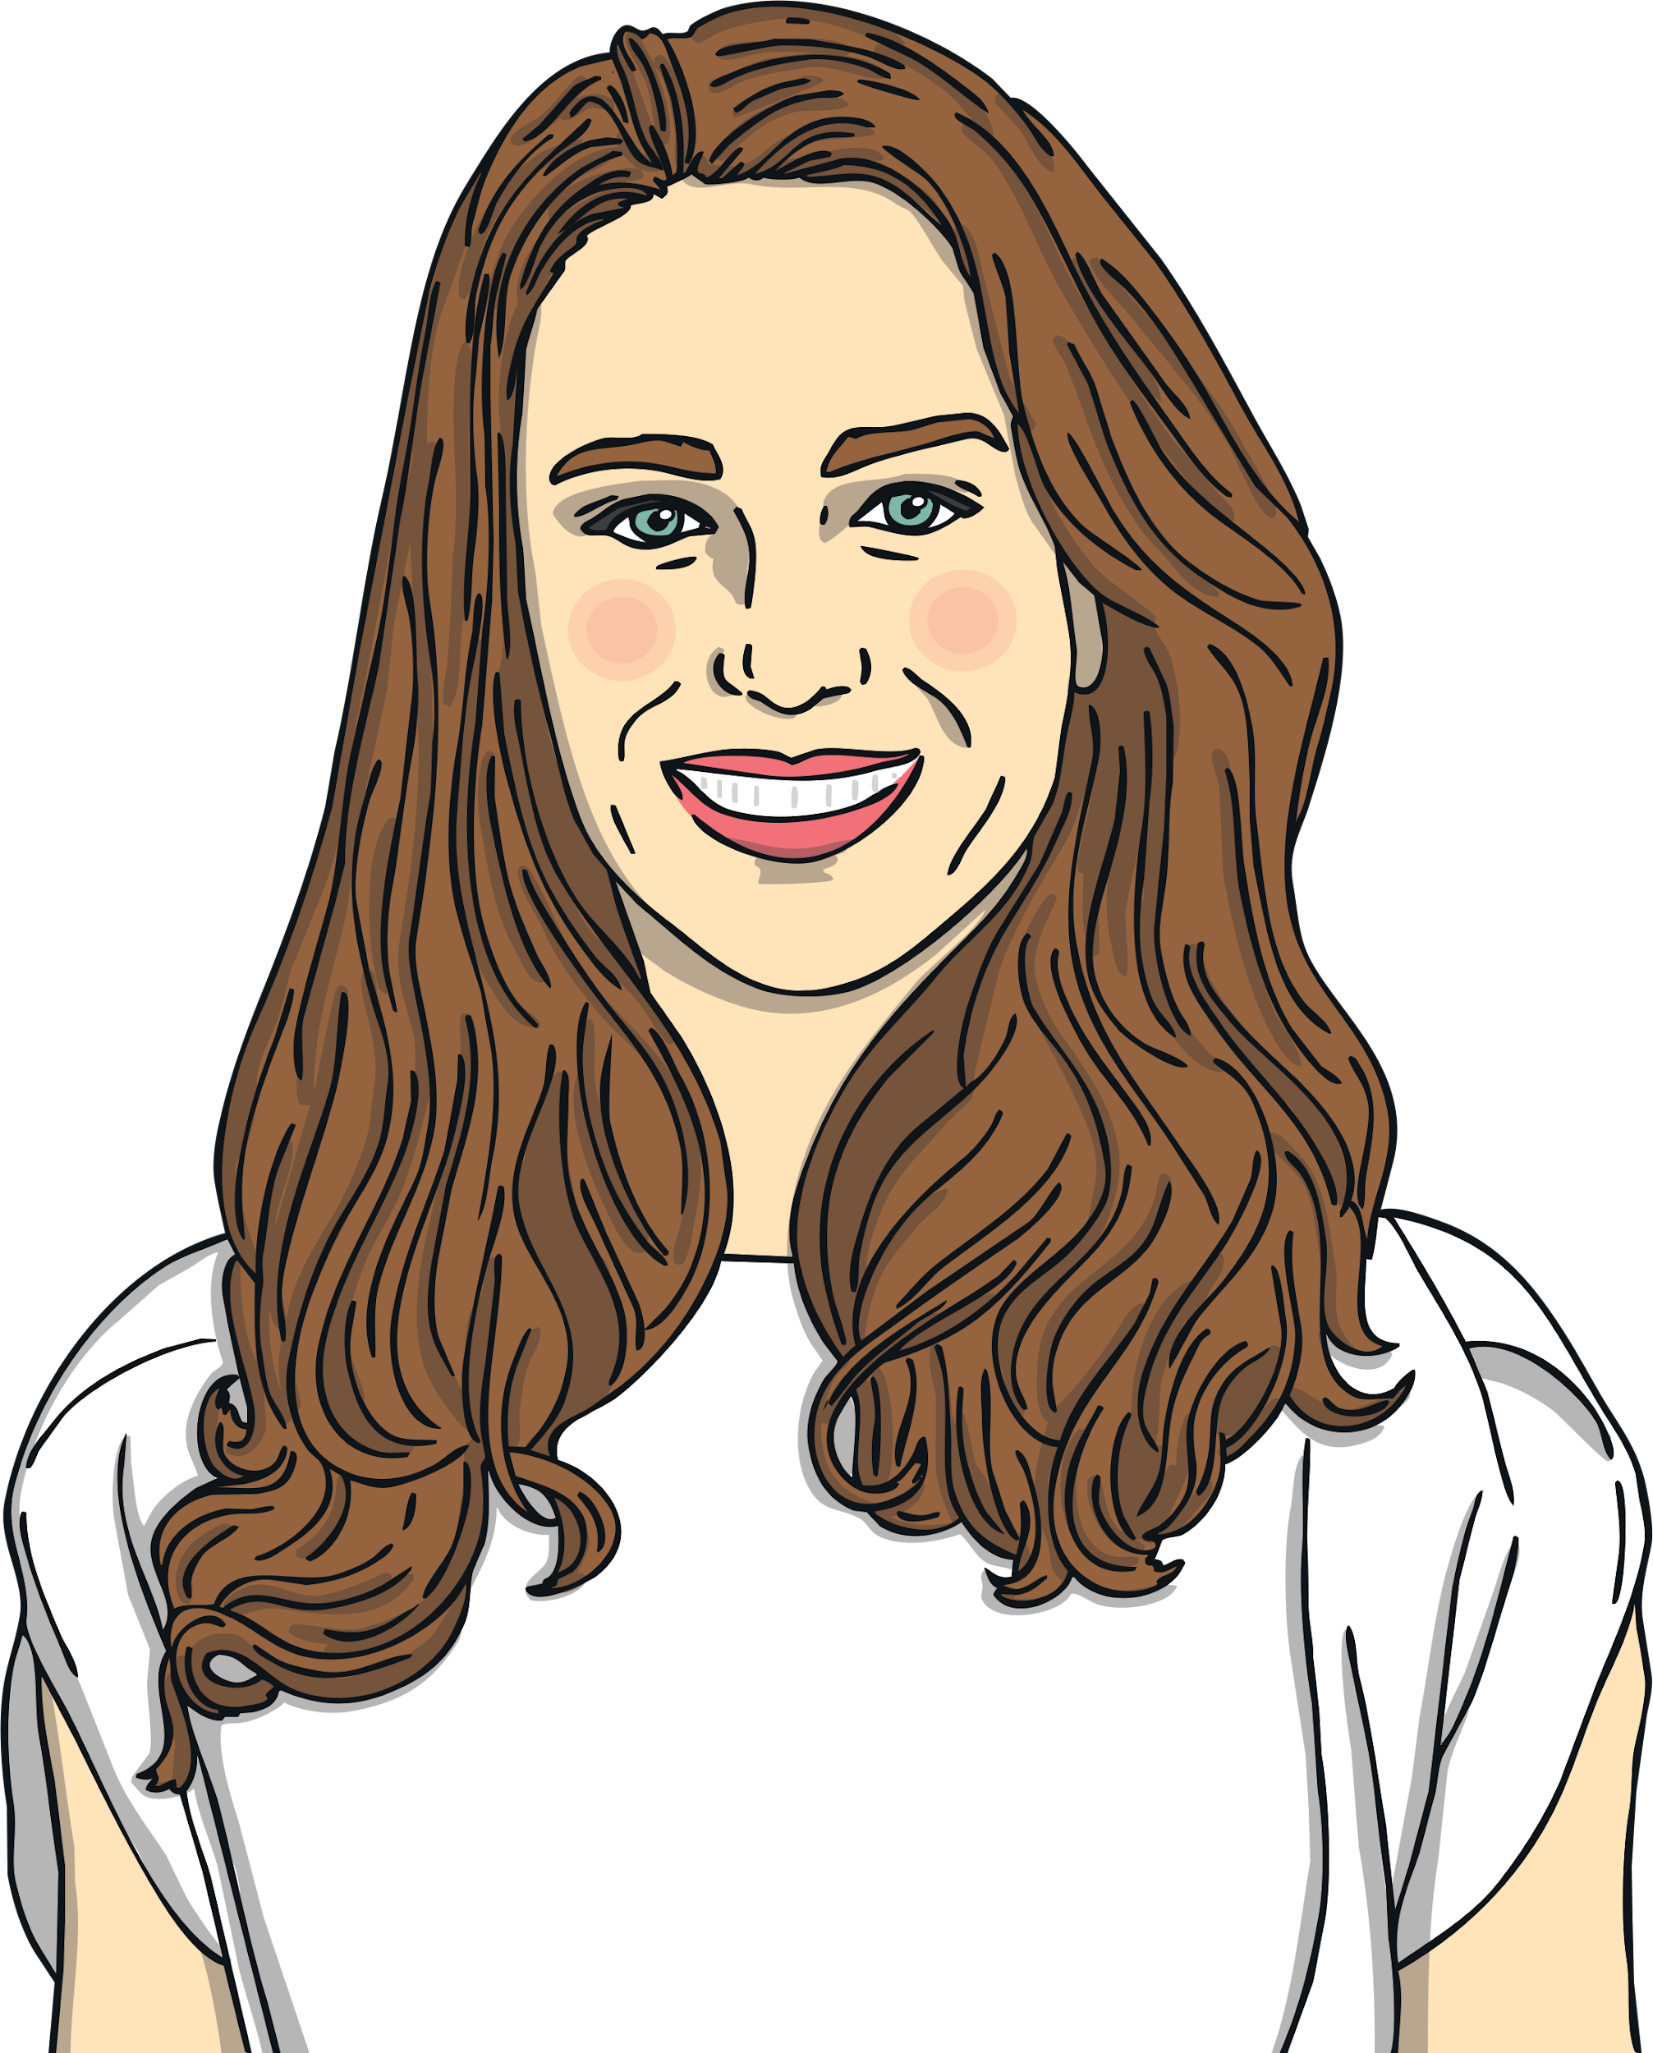
Catherine, Duchess of Cambridge
Catherine’s full name is Catherine Elizabeth Middleton.
Catherine is sometimes known as Kate.
Her royal title is Duchess of Cambridge.
She is married to Prince William.
She is the mother of Prince George, Princess Charlotte and Prince Louis.
When Prince William becomes king, Kate will become queen consort.

Slide 6
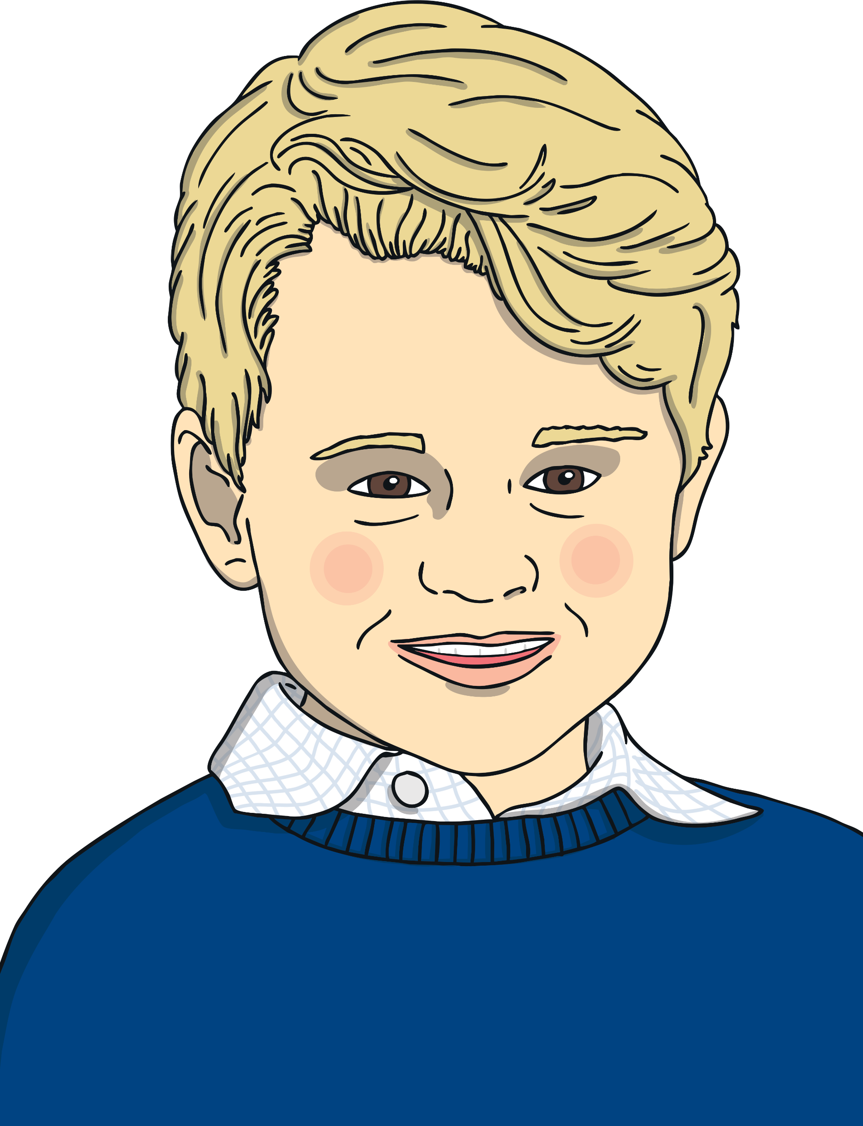
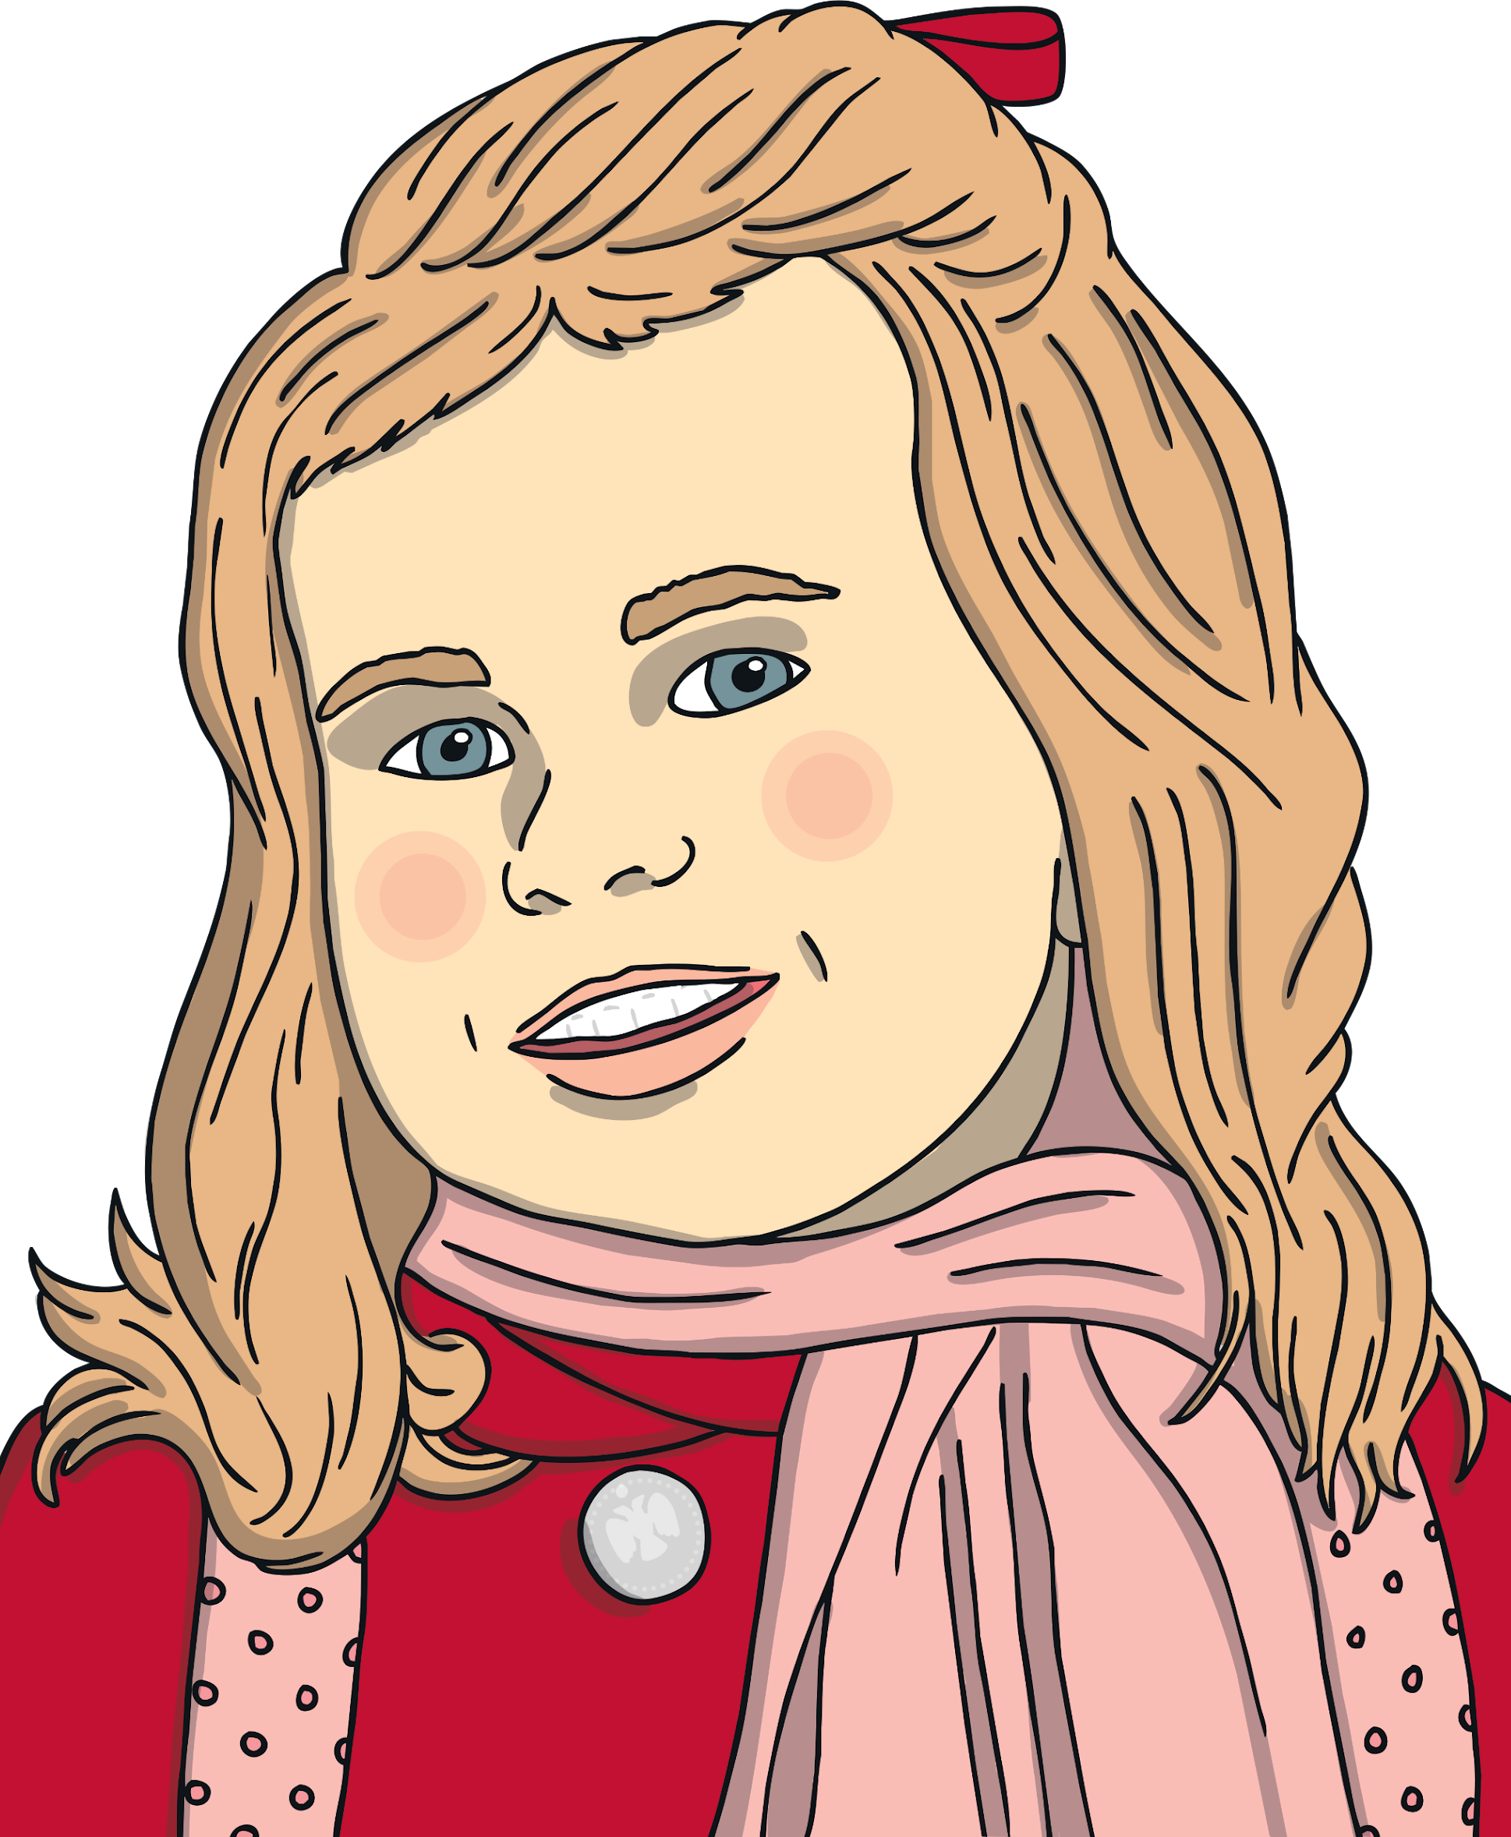
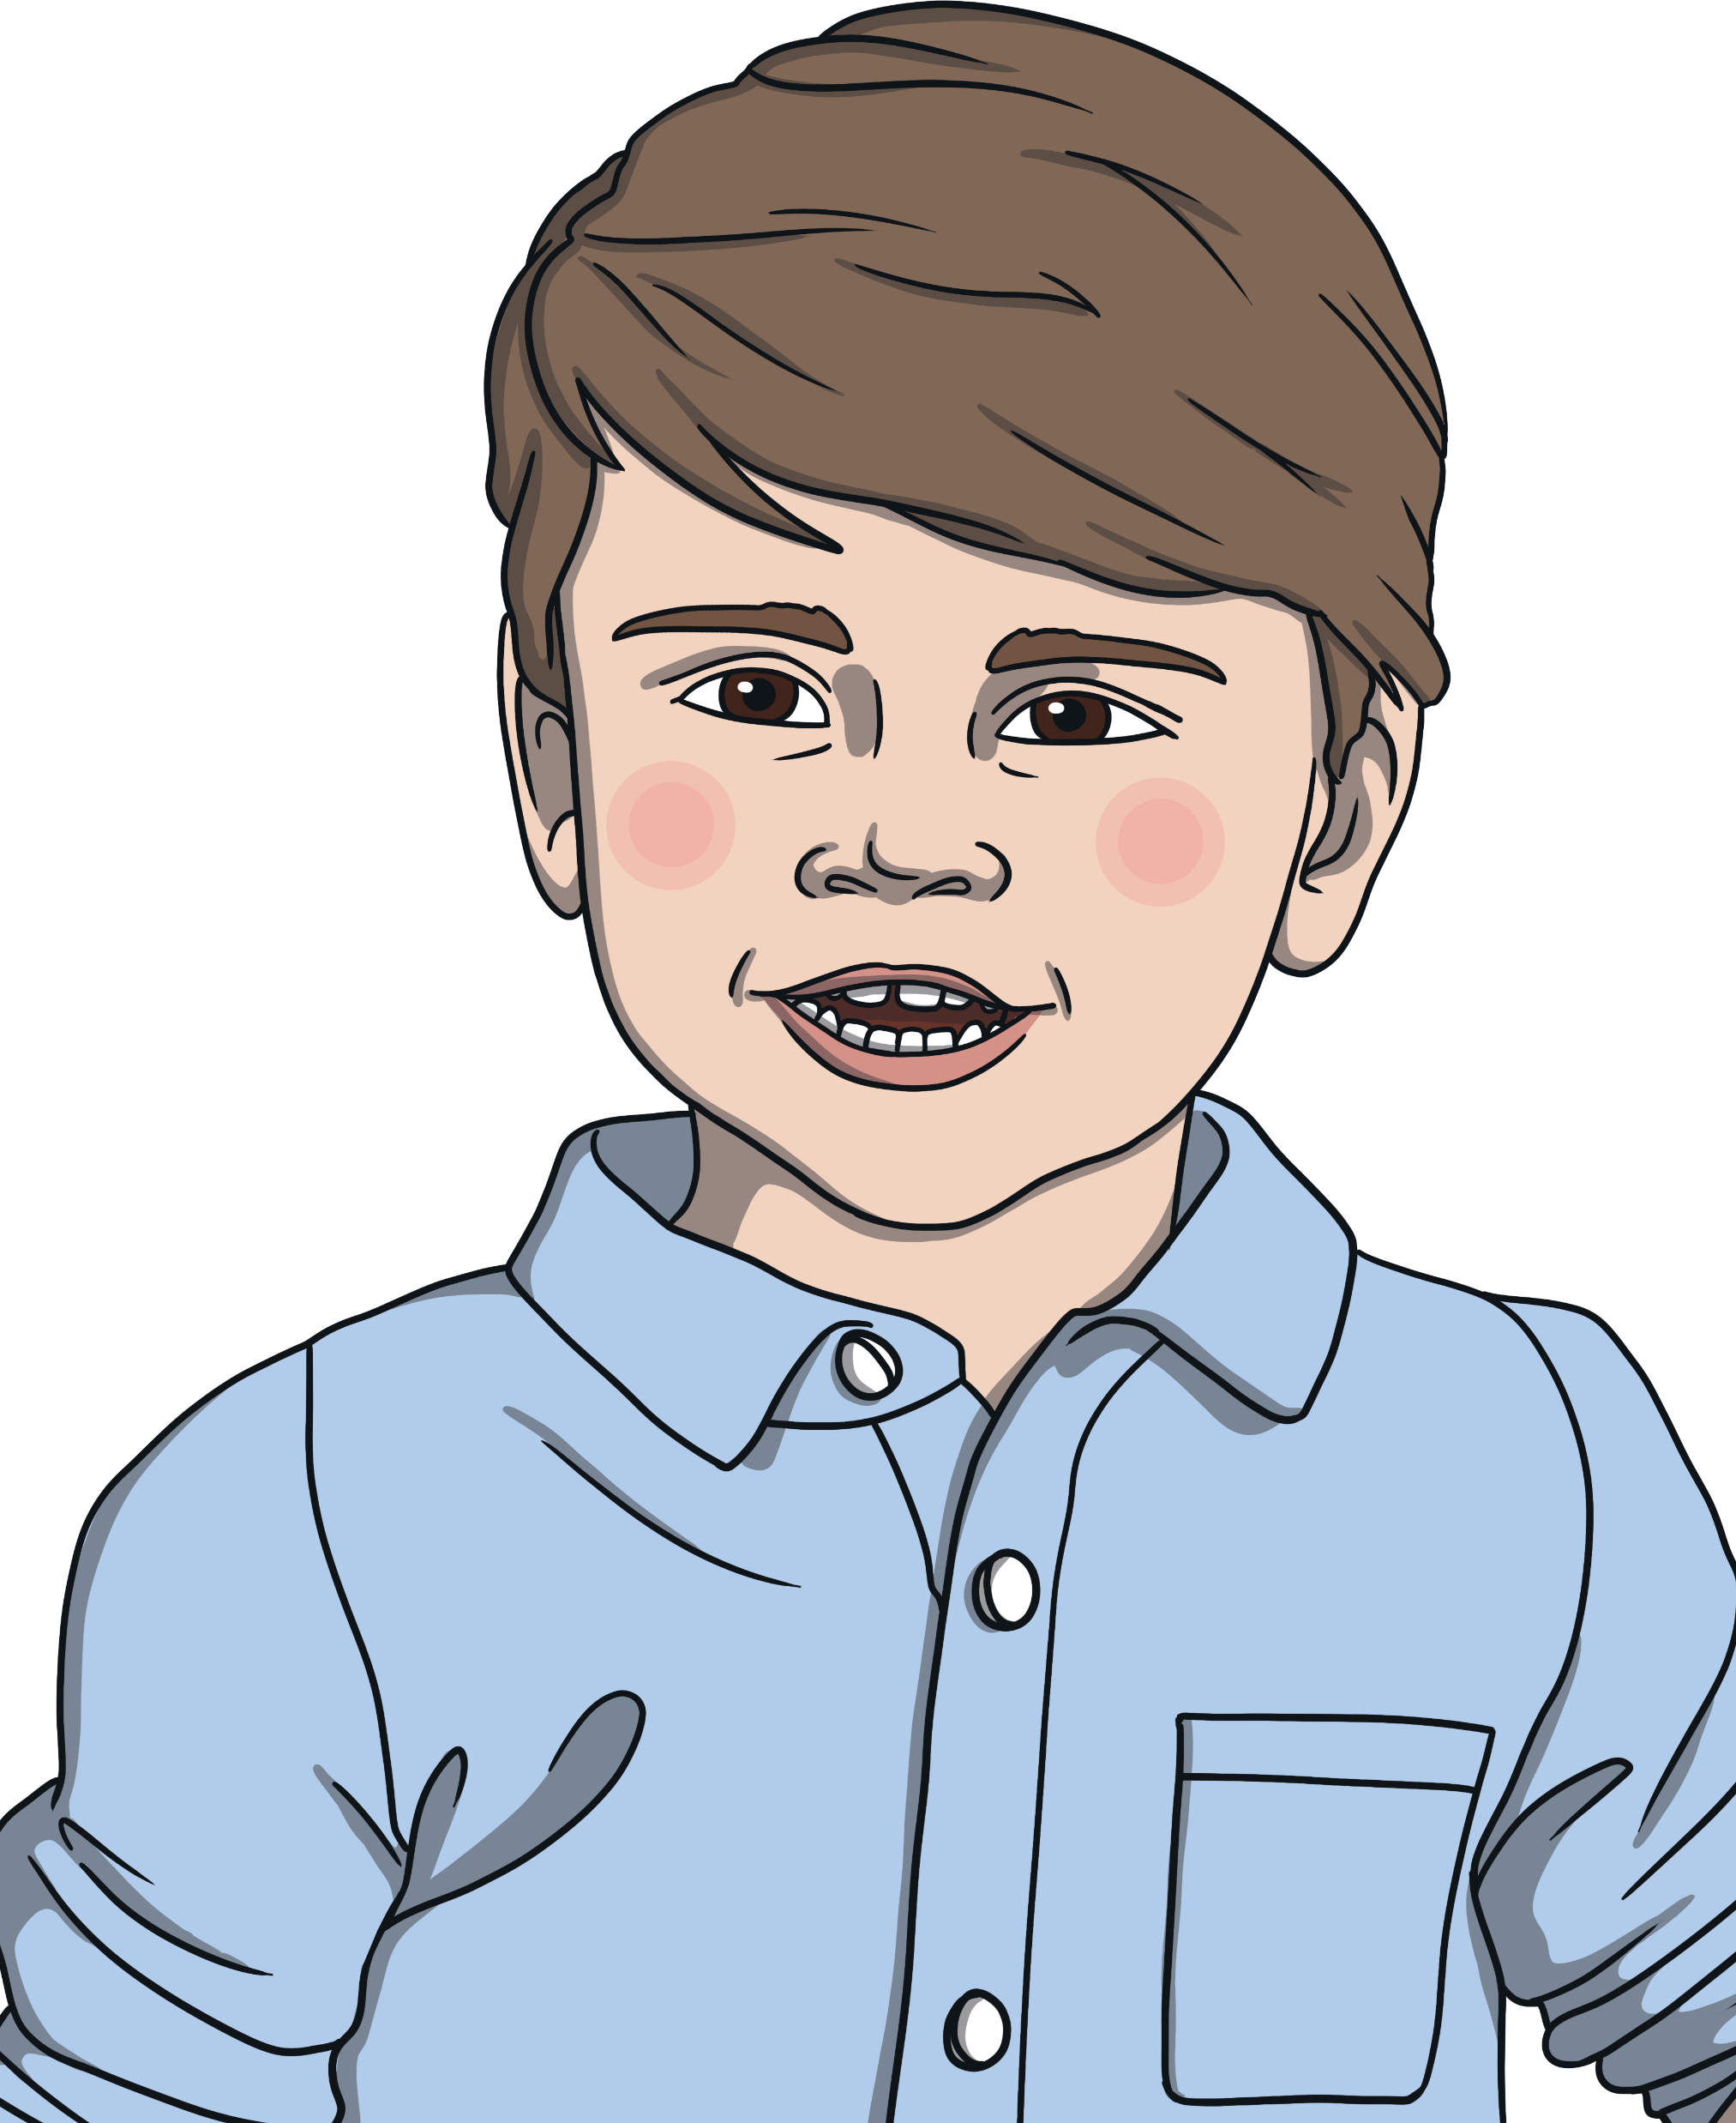
Prince George
Princess Charlotte
Prince Louis
After his father, Prince William, Prince George is next in line to the throne.
That makes him 3rd in line.
Princess Charlotte is currently 4th in line for the throne after Prince George.
If Prince George has children, they will take her place in the line and push her further down.
Prince Louis is 5th in line to the throne.
Like Princess Charlotte, if Prince George has children they will push him further down the line.

Slide 7
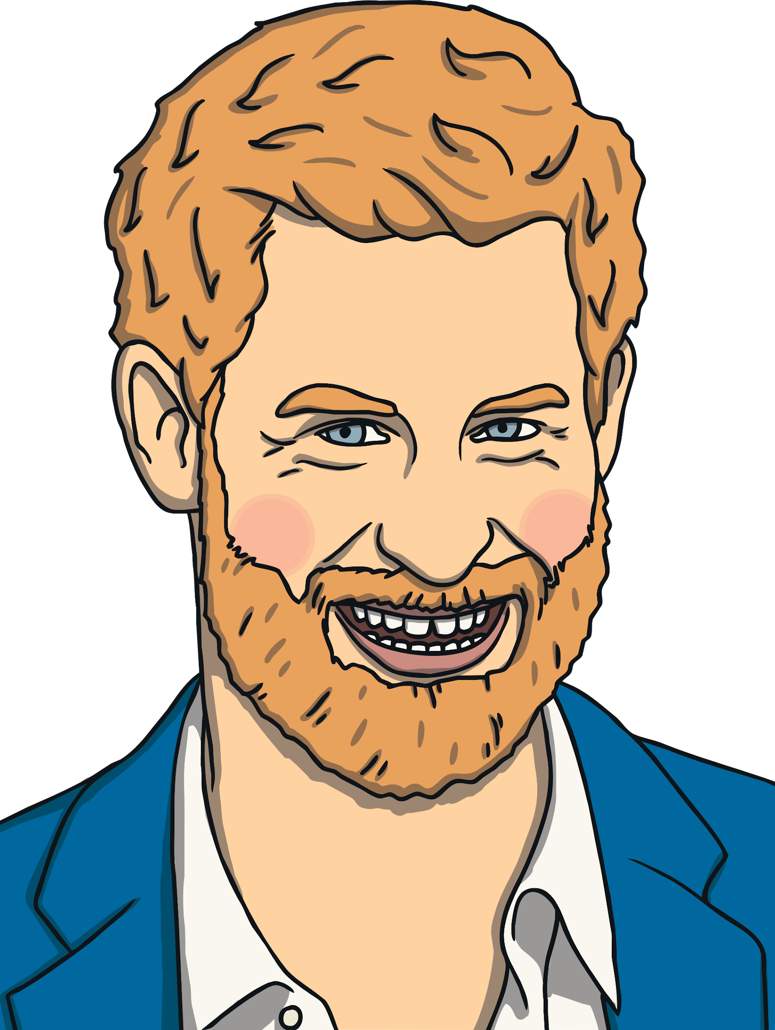
Prince Harry, Duke of Sussex
Prince Harry’s full name is Henry Charles Albert David.
His royal title is Duke of Sussex.
He is married to Meghan, Duchess of Sussex.
He is currently 6th in line to the throne after his father, brother, nephews and niece.
His mother was Diana, Princess of Wales.
He used to be a helicopter pilot in the army.
In 2020, Prince Harry decided not to work as a senior member of the Royal family. This means he will no longer be called 'His Royal Highness' even though he is still a prince.

Slide 8
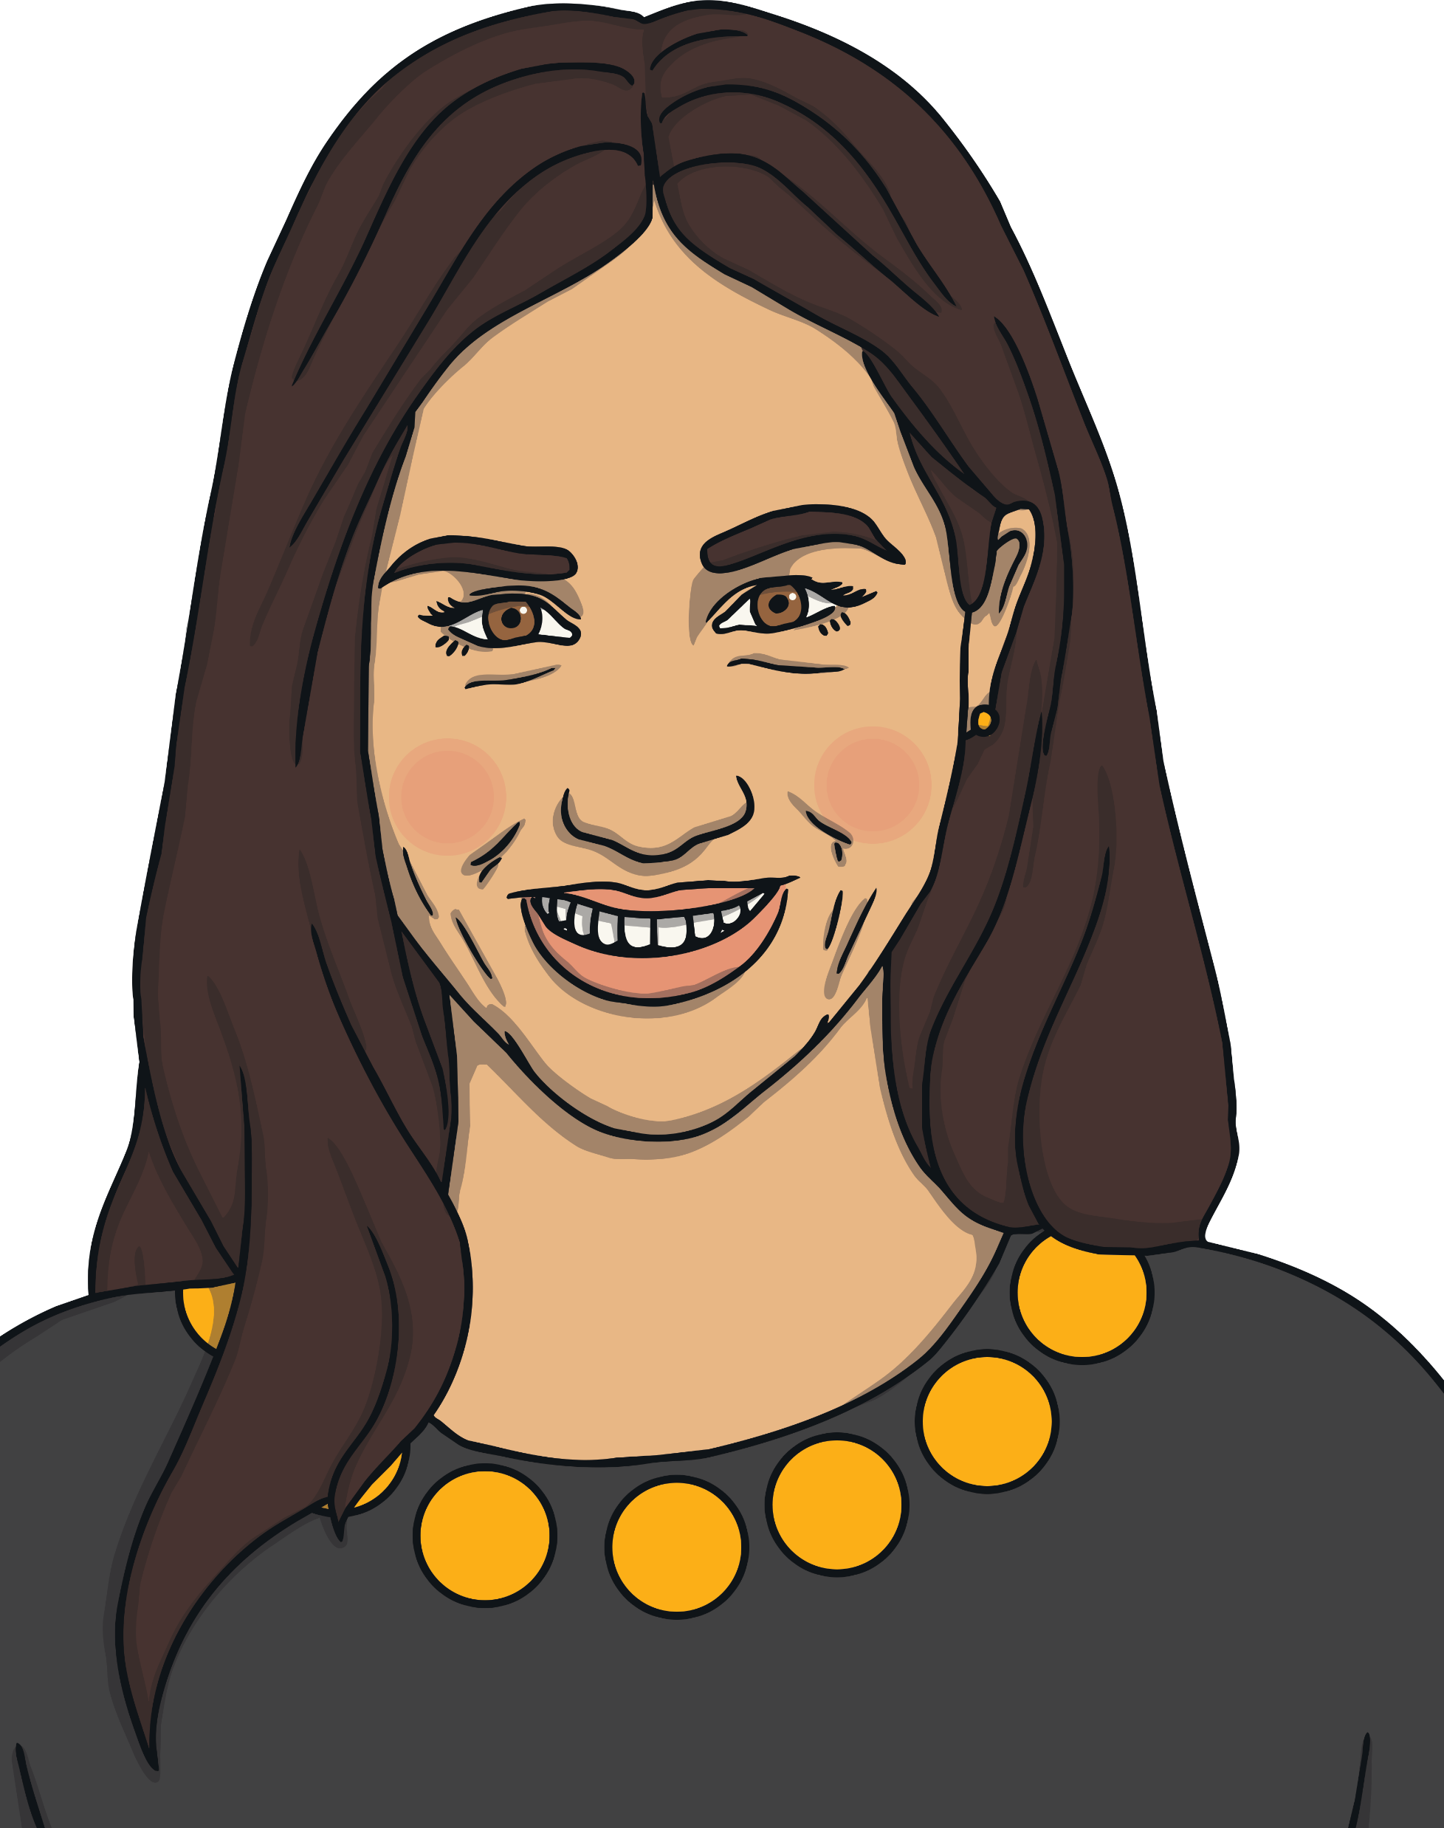
Meghan, Duchess of Sussex
Meghan’s full name is Rachel Meghan Markle.
Her royal title is Duchess of Sussex.
She is married to Prince Harry.
Meghan was born in America but is now a British citizen.
Before becoming part of the royal family she worked as an actress.
Along with Prince Harry, Meghan decided not to work as a member of the Royal family, and to live some of the time in Canada.

Slide 9
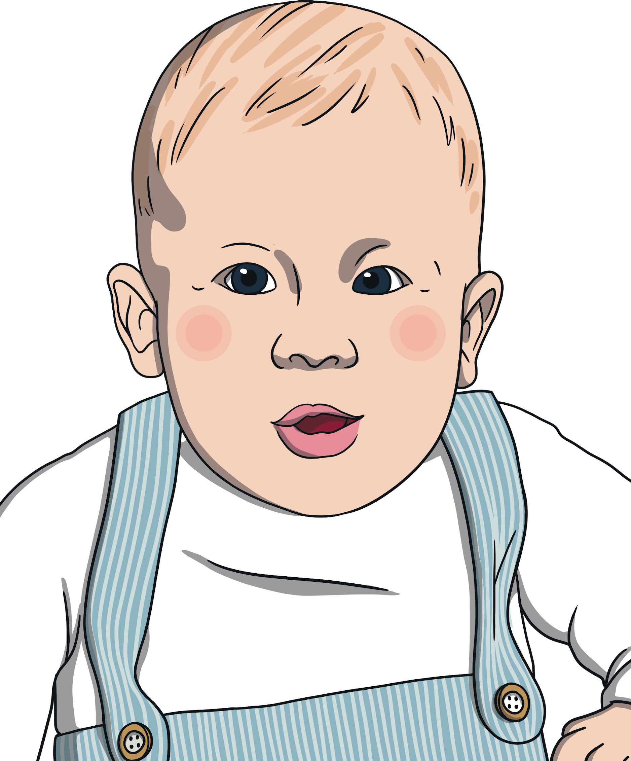
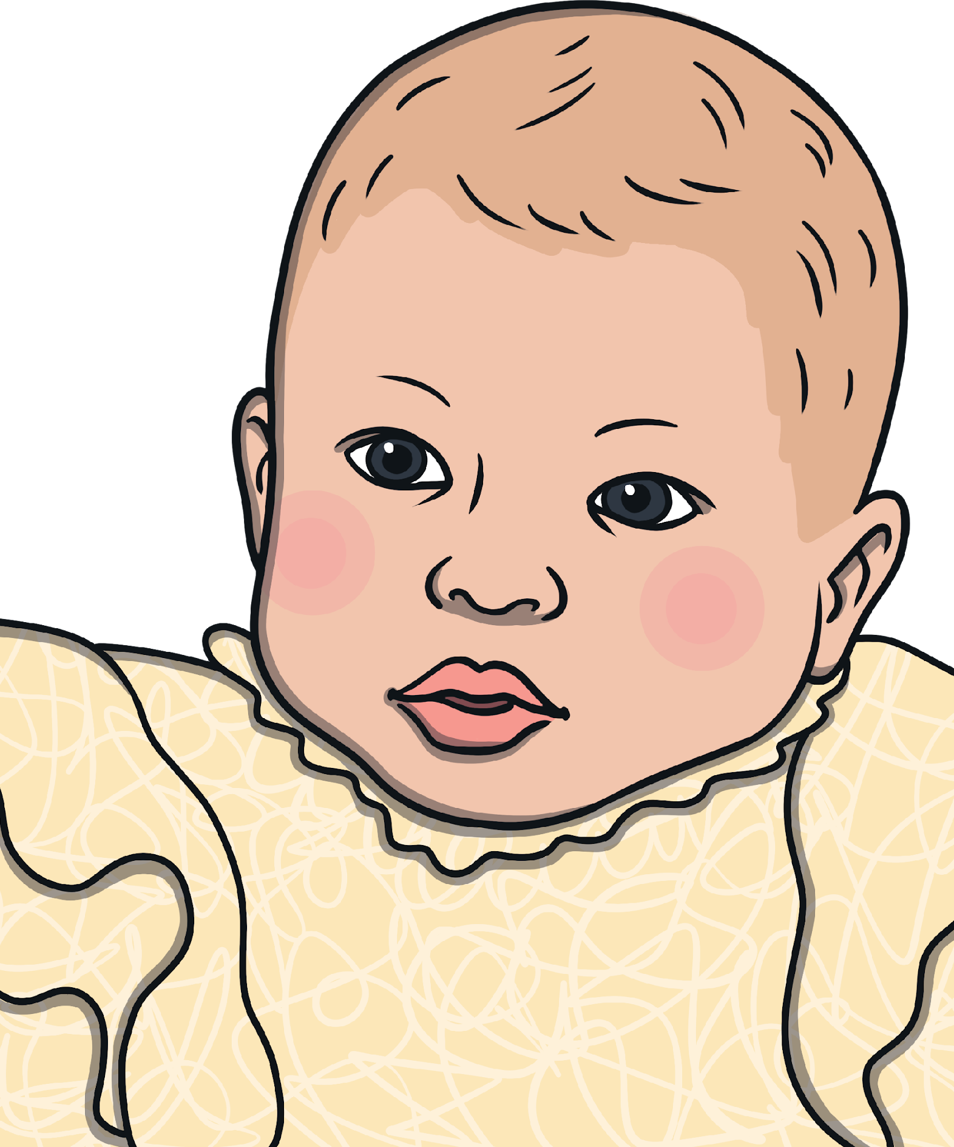
Archie Harrison Mountbatten-Windsor
Lilibet Diana Mountbatten-Windsor
Archie is the son of Prince Harry, Duke of Sussex and Meghan, Duchess of Sussex.
He was born on 6th May 2019.
Archie is 7th in line to the throne after his grandfather, uncle, cousins and father.
Archie does not have a title, such as ‘Prince’, ‘Duke’ or ‘Earl’ and is known as Master Archie Mountbatten-Windsor. This is because his parents want him to grow up as a private citizen.
Lilibet is the daughter of Prince Harry, Duke of Sussex and Meghan, Duchess of Sussex.
She was born on 4th June 2021.
Lilibet is 8th in line to the throne after her grandfather, uncle, cousins and father.
Lilibet is named after Queen Elizabeth II (whose nickname is ‘Lilibet’) and her grandmother, Princess Diana.
Archie and Lilibet do not have titles, such as ‘Prince’, ‘Princess’, ‘Duke’ or ‘Duchess’. This is because their parents want them to grow up as private citizens.

Slide 10
The Royal Family
Princess Anne
Prince Andrew
Prince Edward
King Charles
The Queen Consort
Catherine, Duchess of Cambridge
Prince William
(2nd in line to the throne)
Prince Harry
(6th in line to the throne)
Meghan, Duchess of Sussex
Prince George
(3rd in line to the throne)
Princess Charlotte
(4th in line to the throne)
Prince Louis
(5th in line to the throne)
Archie Mountbatten-Windsor
(7th in line to the throne)
Lilibet Mountbatten-Windsor
(8th in line to the throne)

